Slide 1
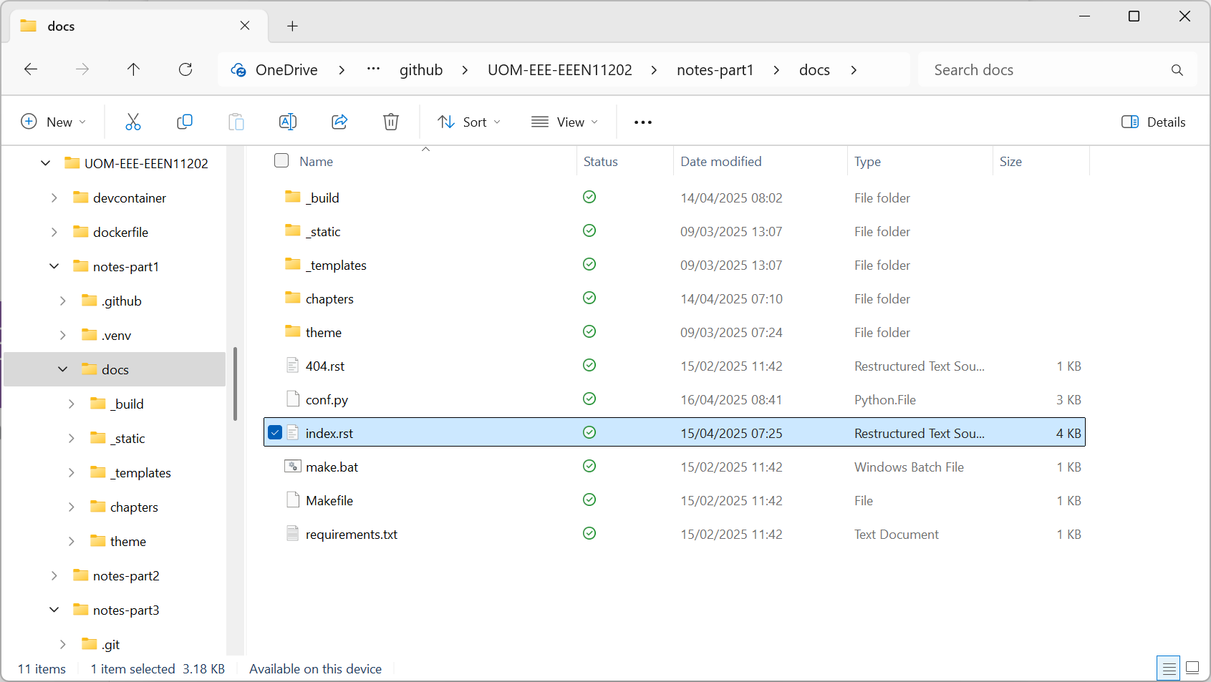
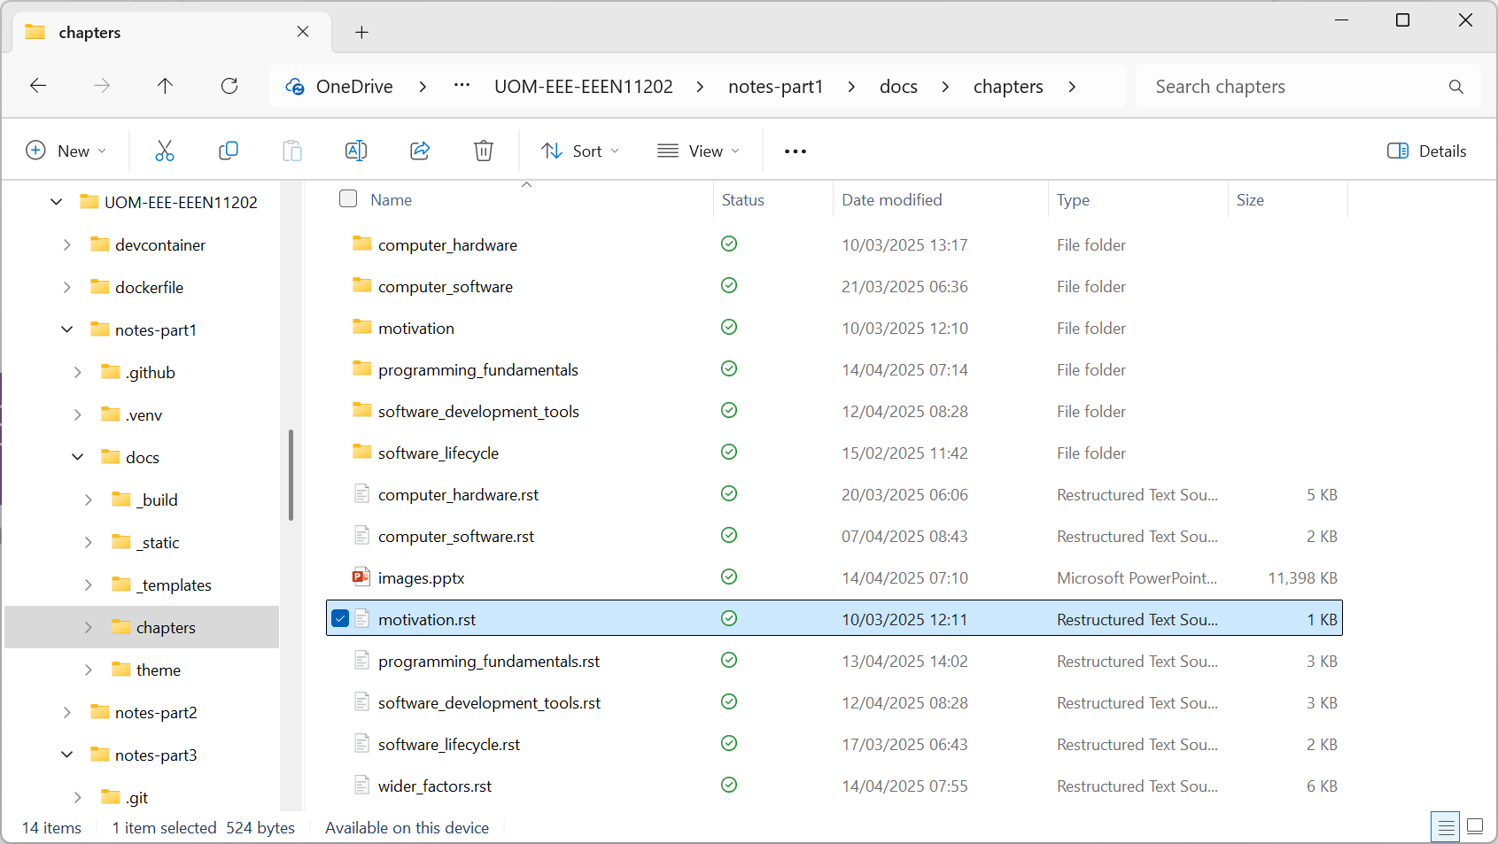

Slide 2
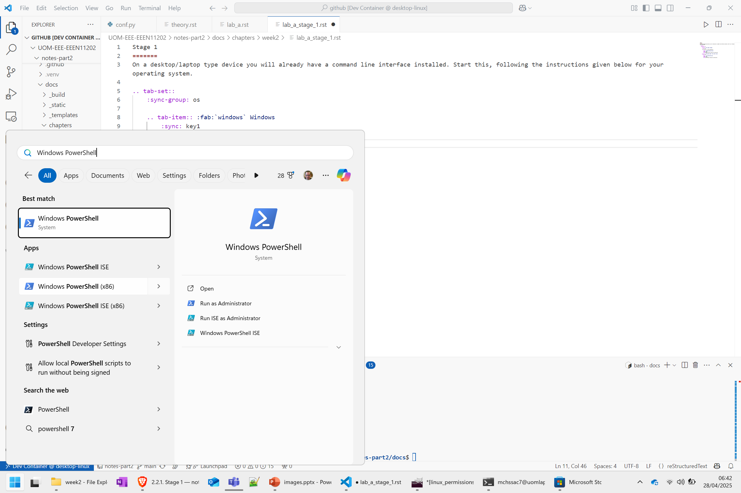

Slide 3
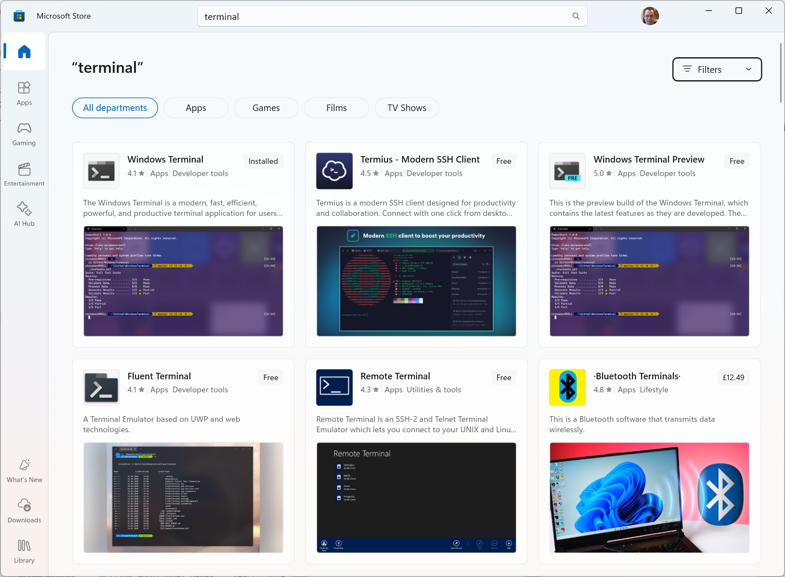

Slide 4
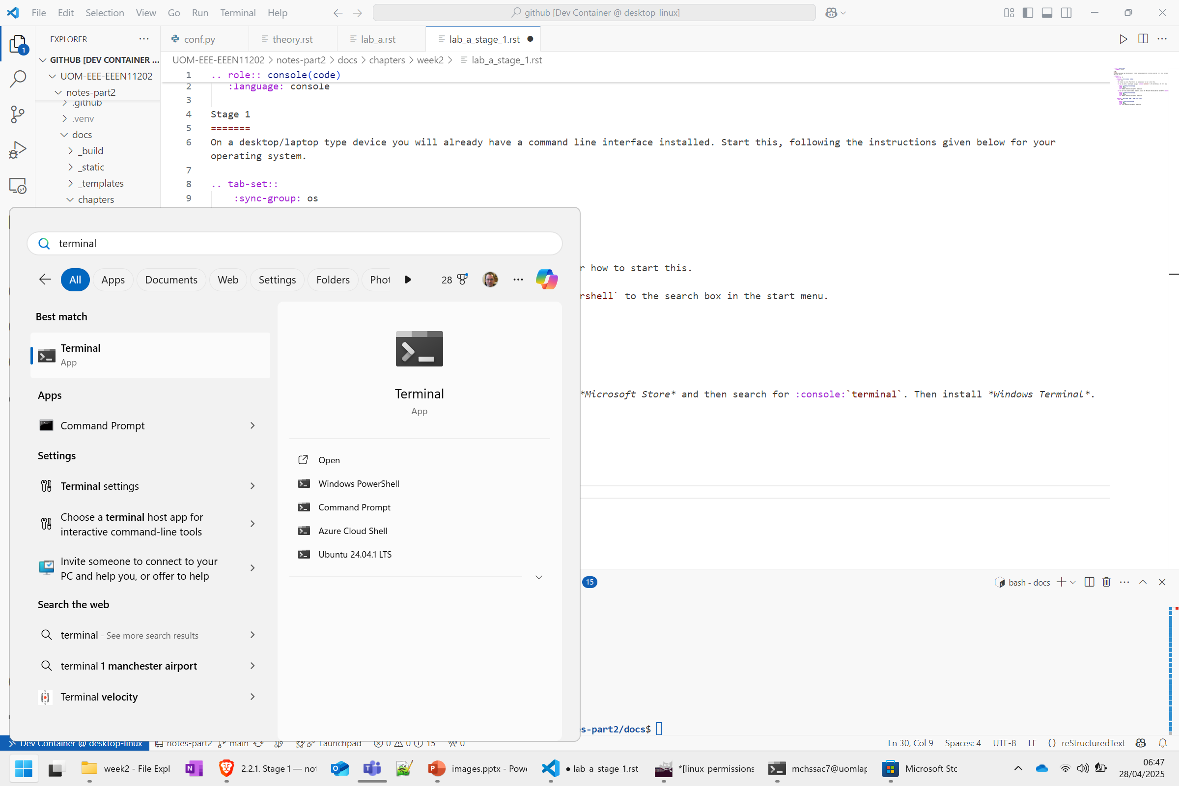

Slide 5
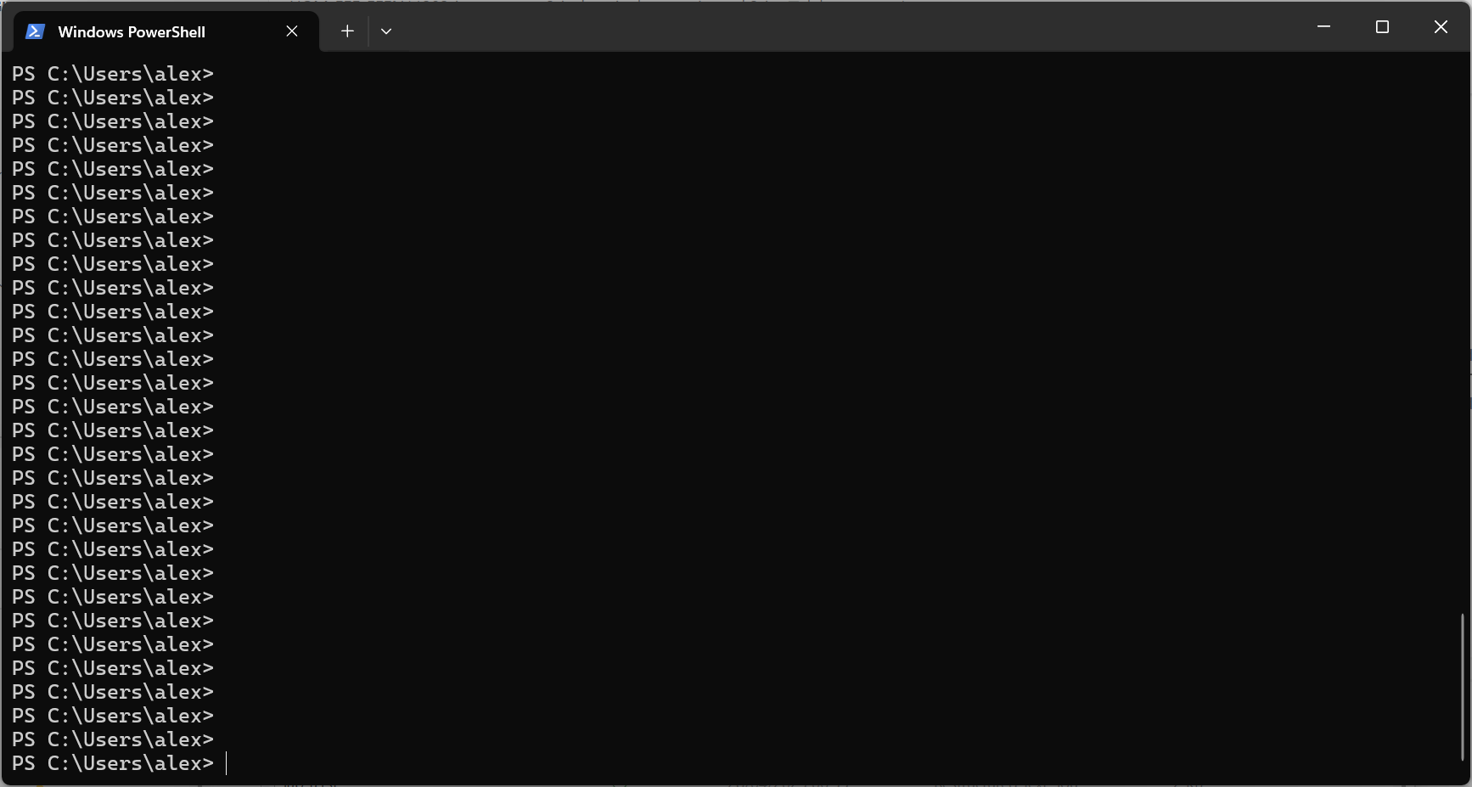
Prompt showing where to type commands

Slide 6
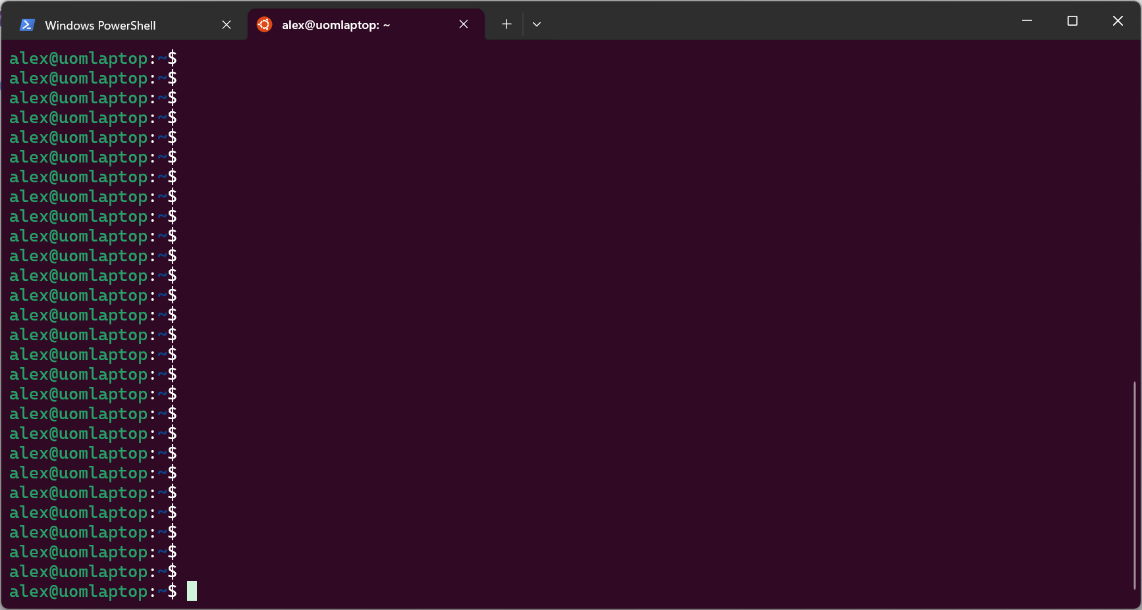
Prompt showing where to type commands

Slide 7
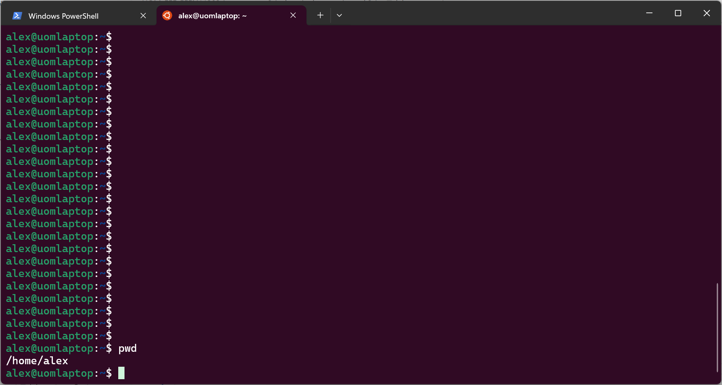
Command input
Command output

Slide 8
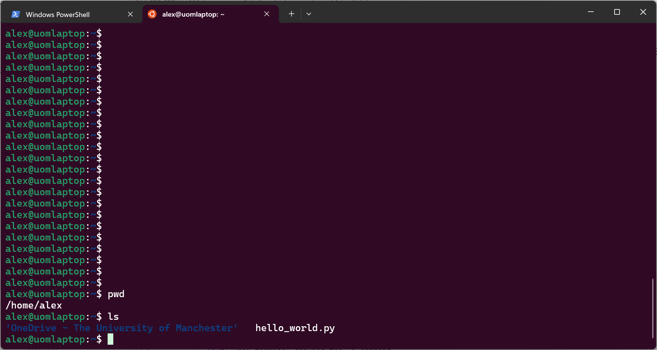
Command input
Command output

Slide 9
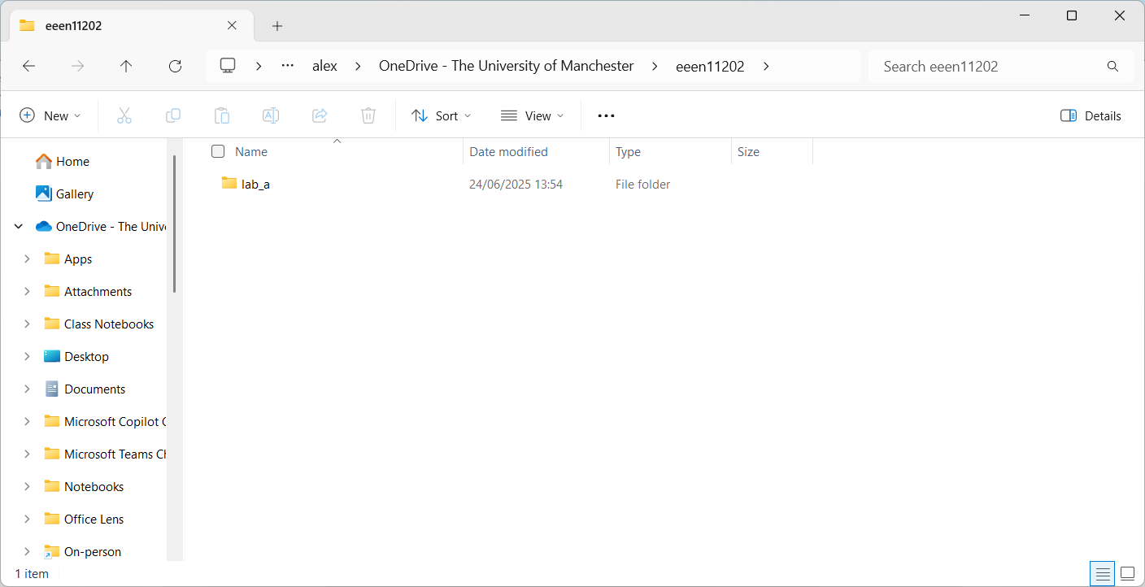

Slide 10
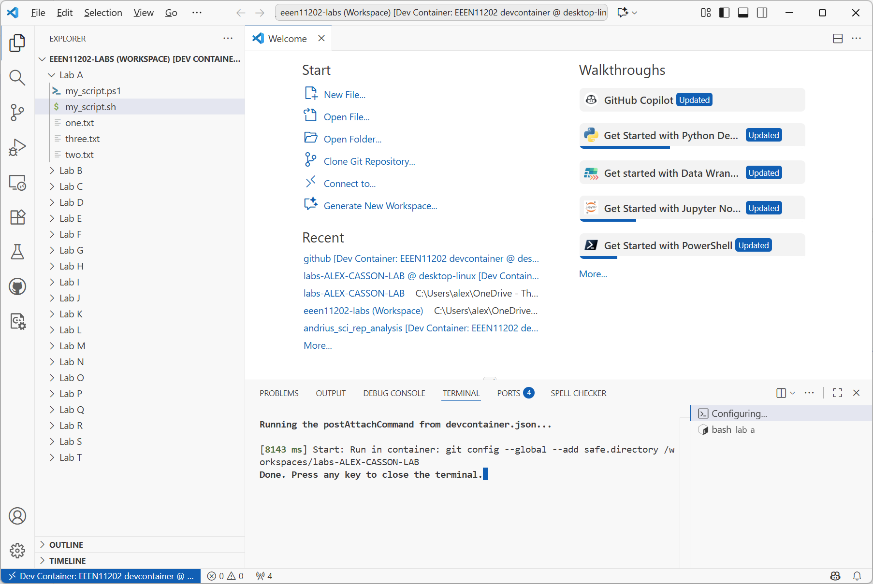

Slide 11
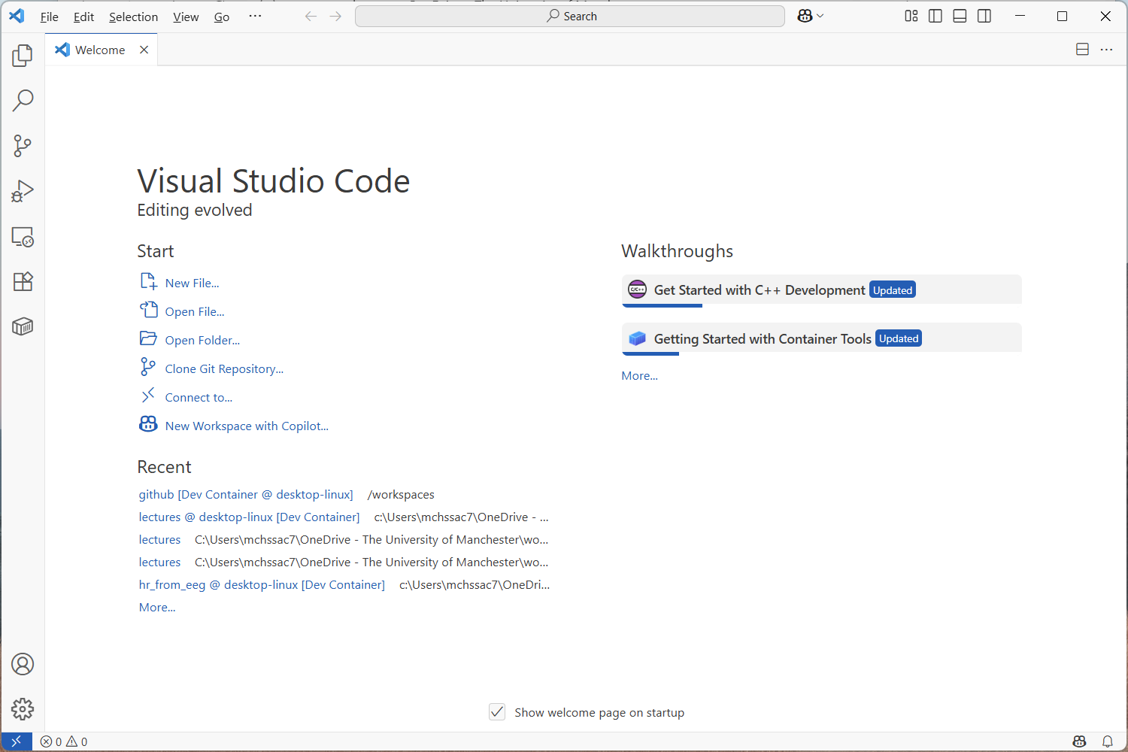

Slide 12
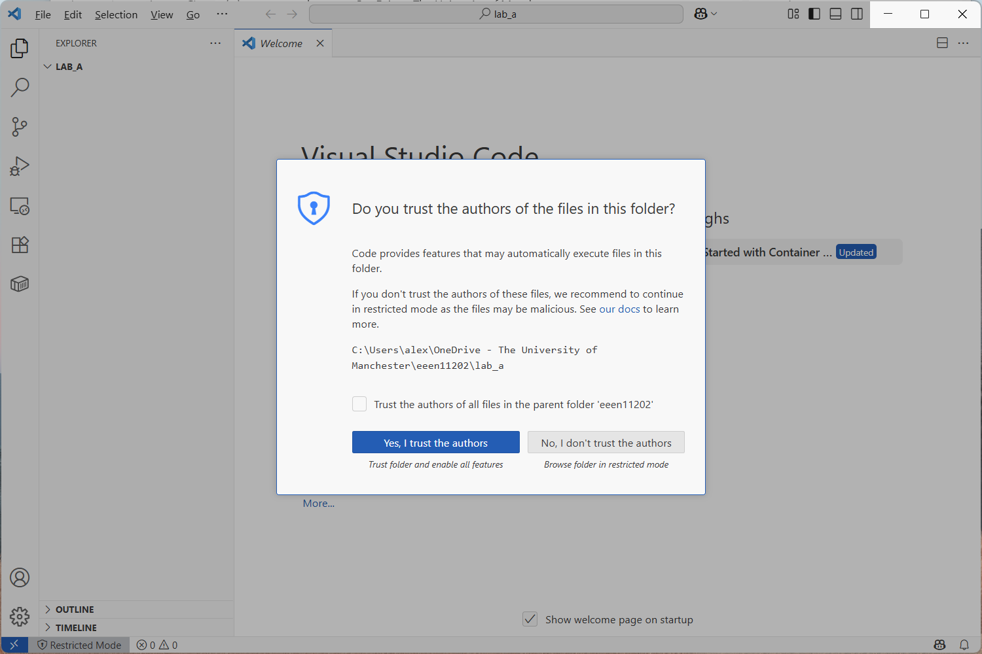

Slide 13
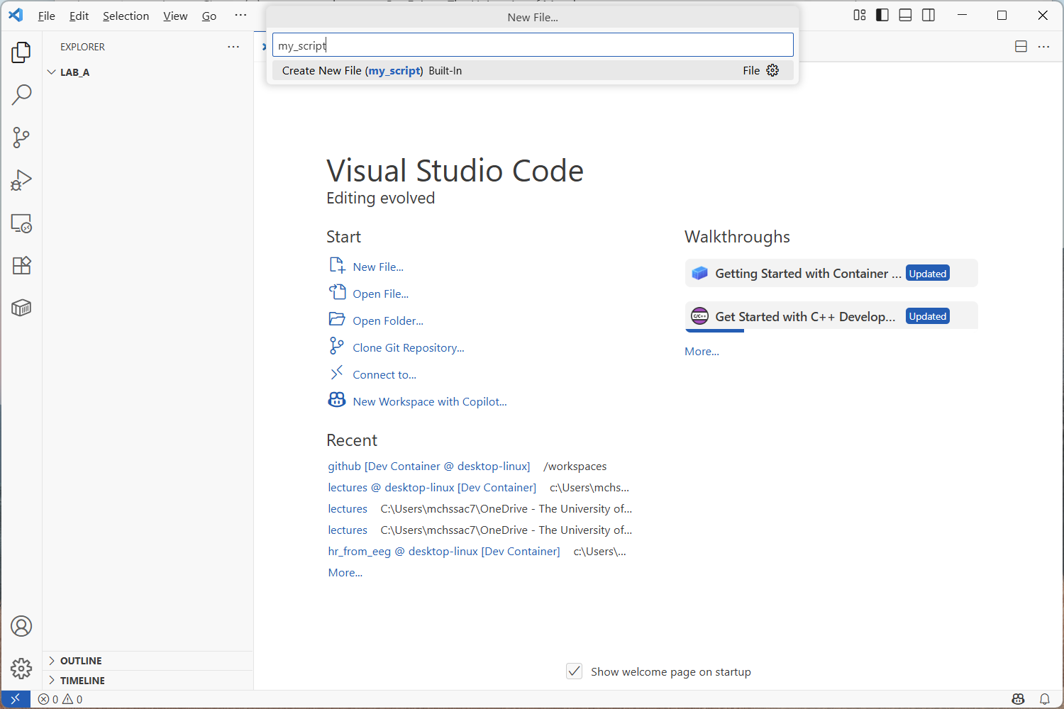
2. Enter file name here (it will appear after you click New File…)
Remember to include the extension
Name of the folder that’s been opened
Files in the folder (if any) will appear here
1. Click New File…

Slide 14
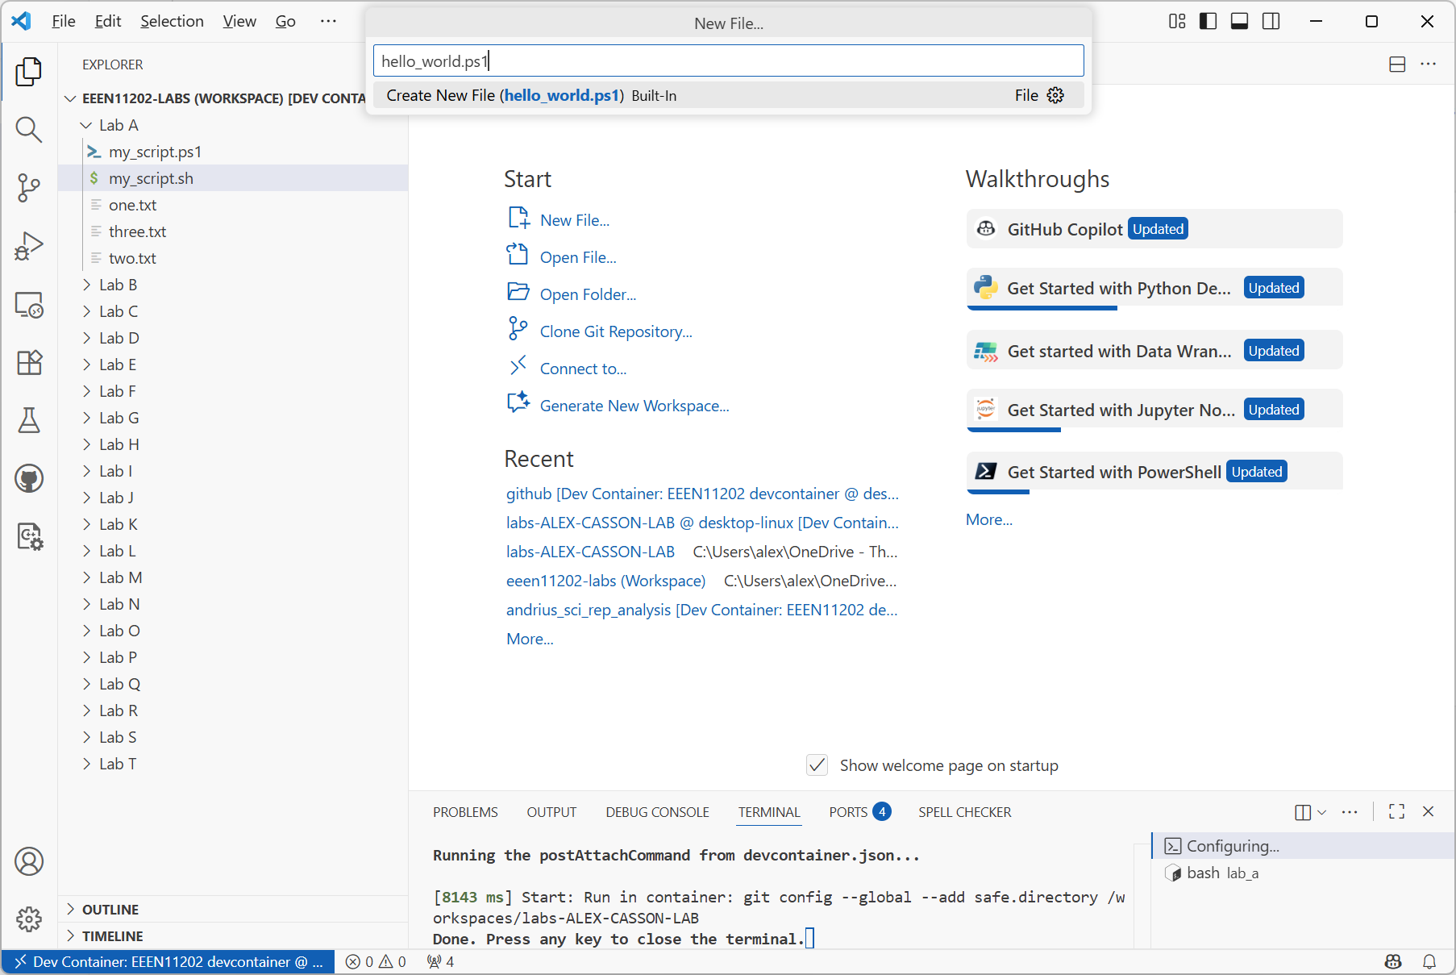
2. Enter file name here (it will appear after you click New File…)
Remember to include
the extension
Name of the folder that’s been opened
1. Click New File…
Files in the folder (if any) will appear here

Slide 15
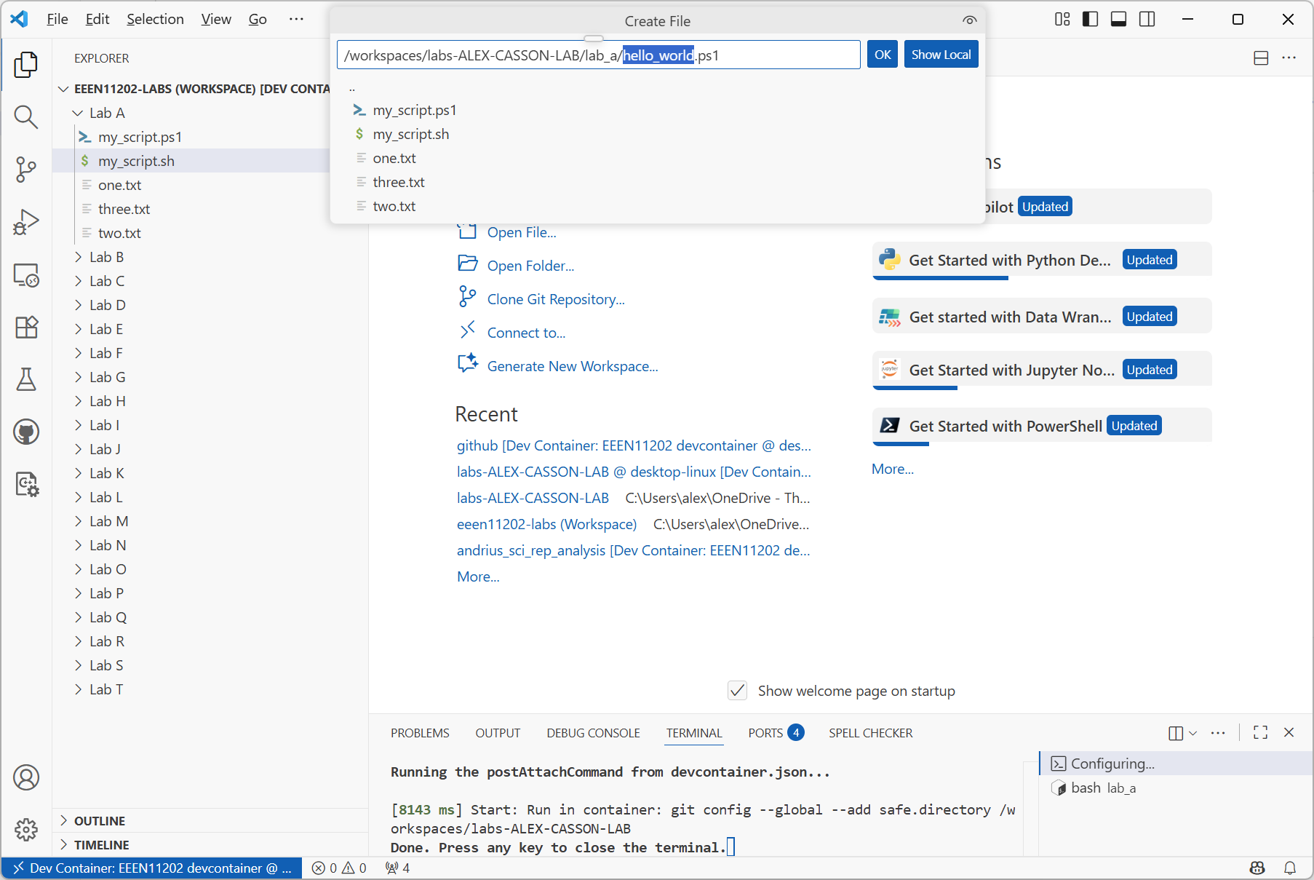

Slide 16
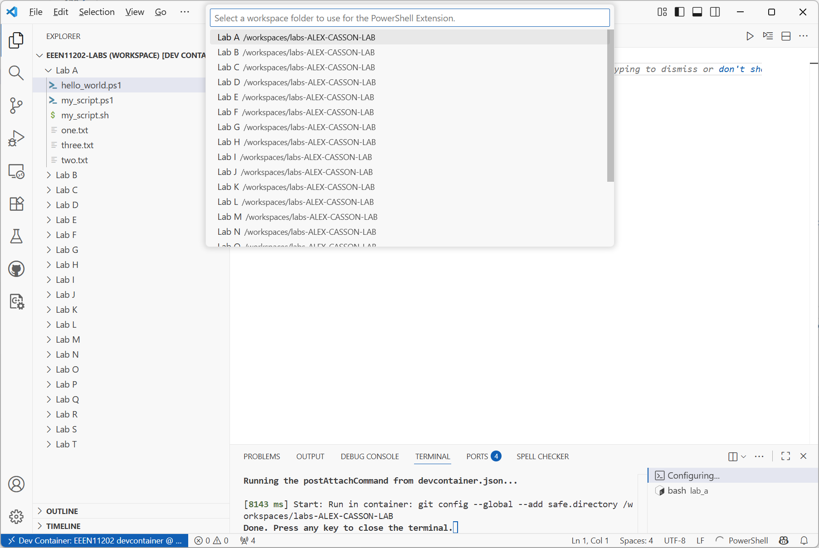

Slide 17
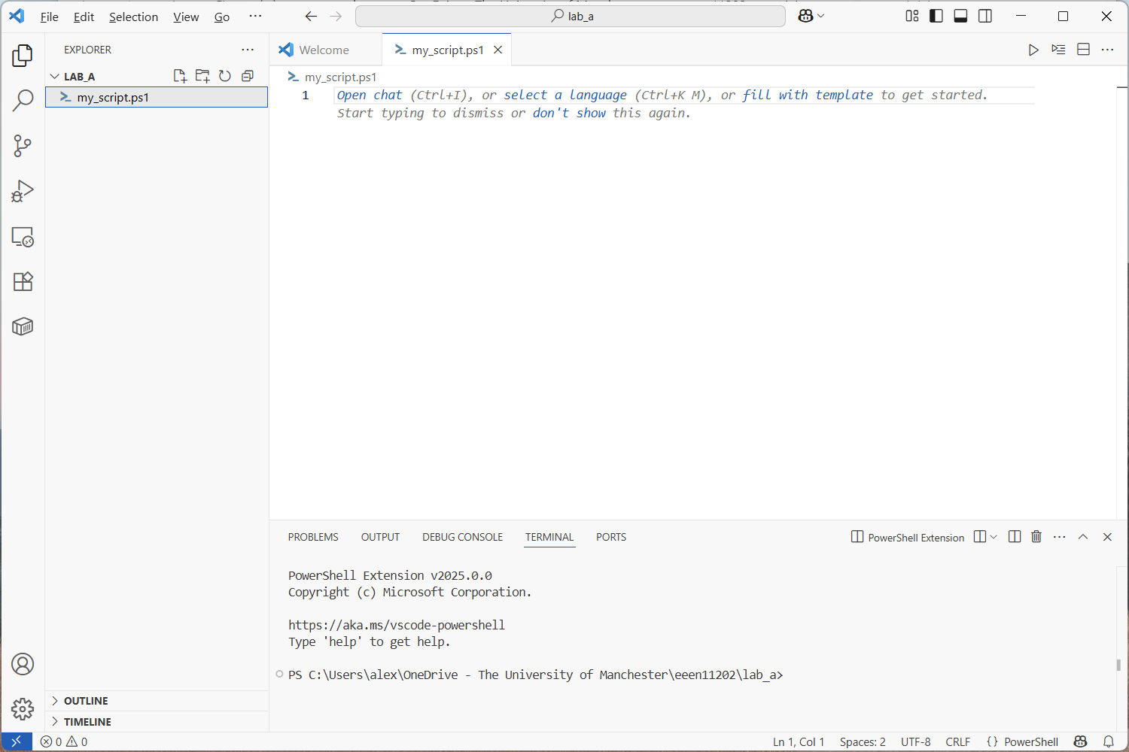
Area to start entering commands
Built in terminal prompt

Slide 18
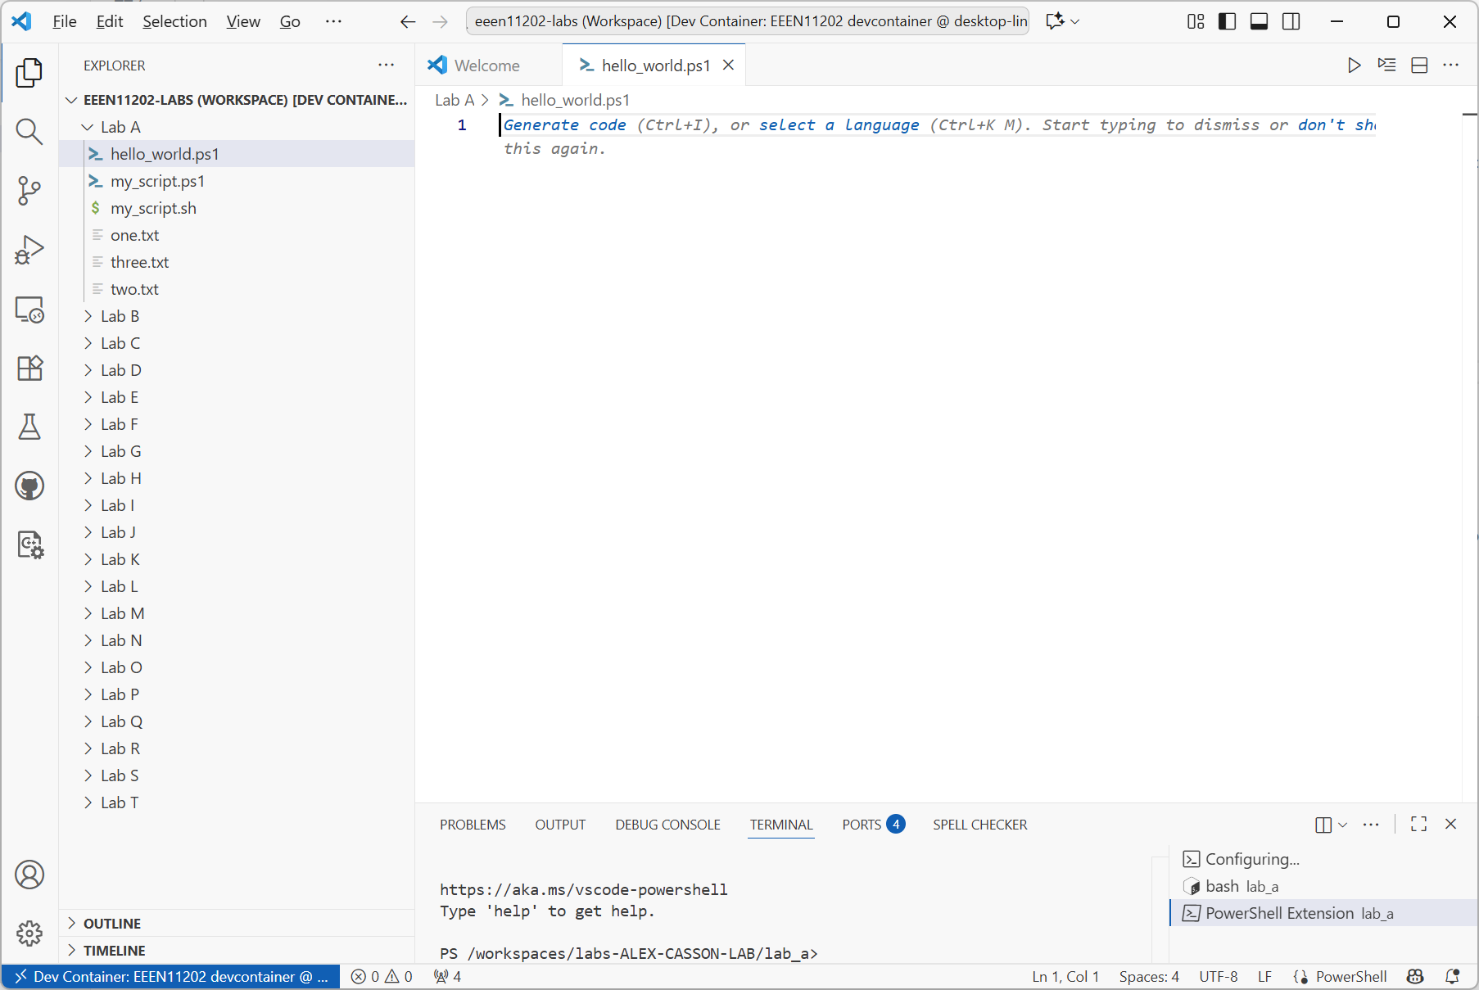
Area to start entering commands
Lab files (some have already been made by us for you)
Built in terminal prompt

Slide 19
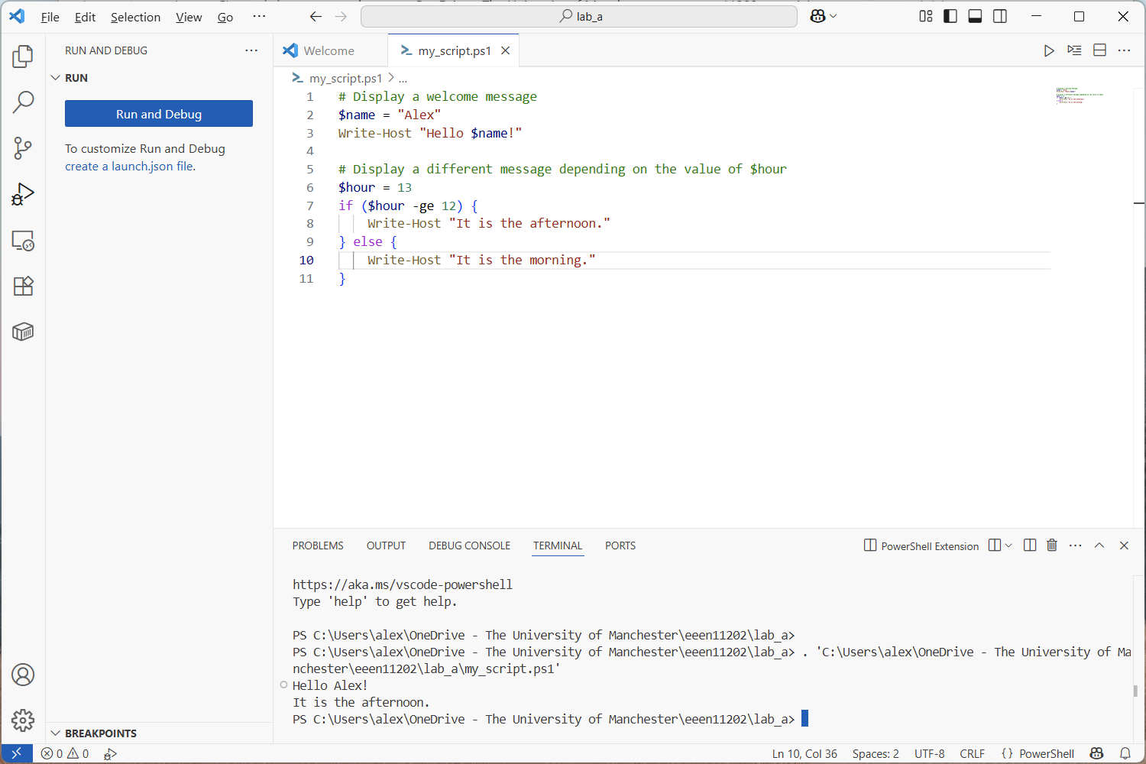
Run button
Displayed output

Slide 20
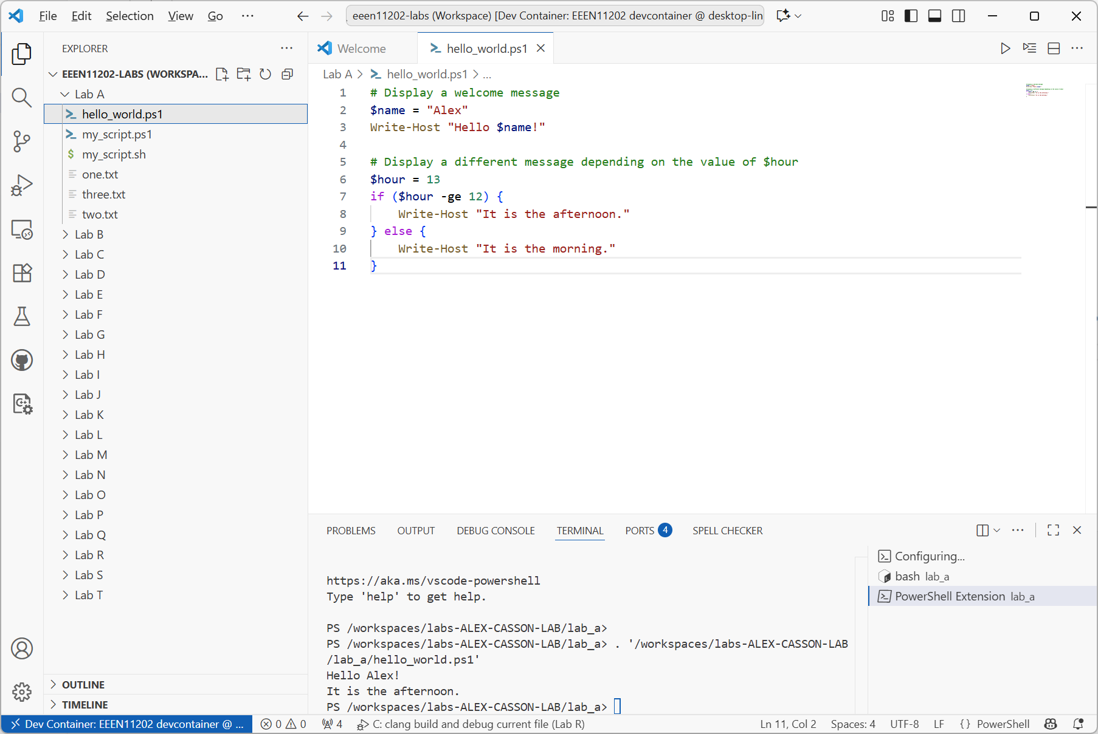
Run button
Displayed output

Slide 21
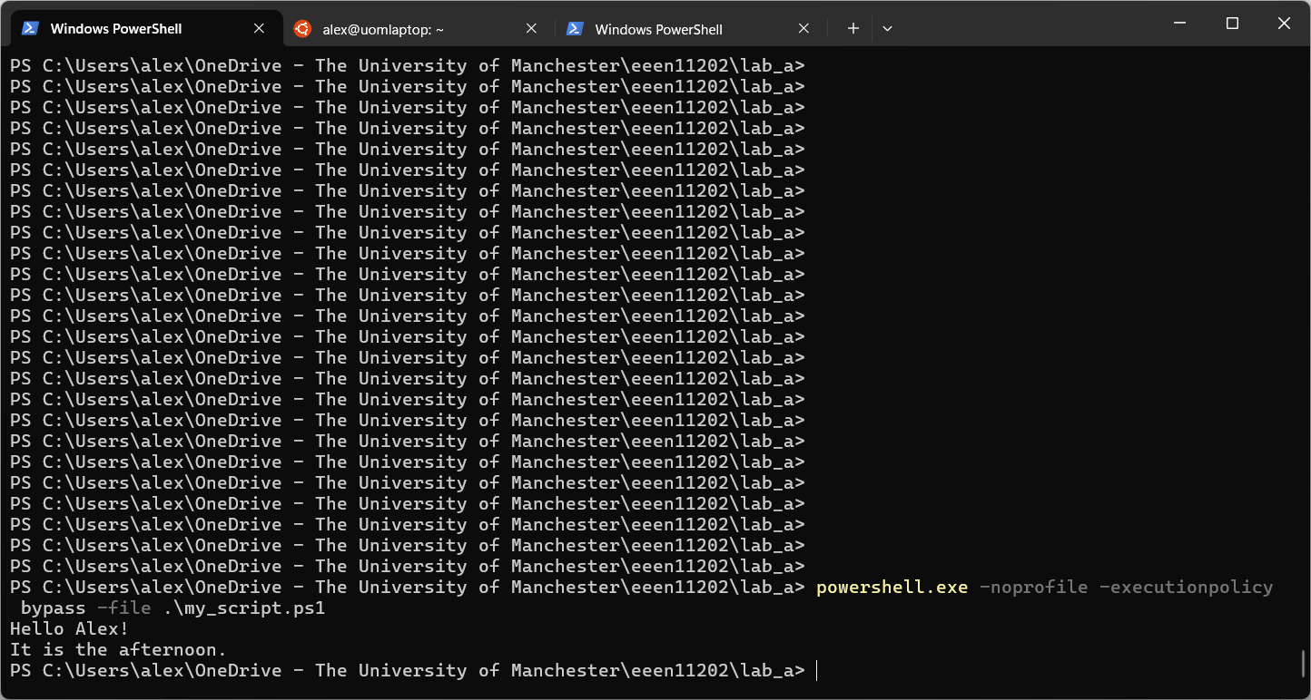
Input command
Displayed output

Slide 22
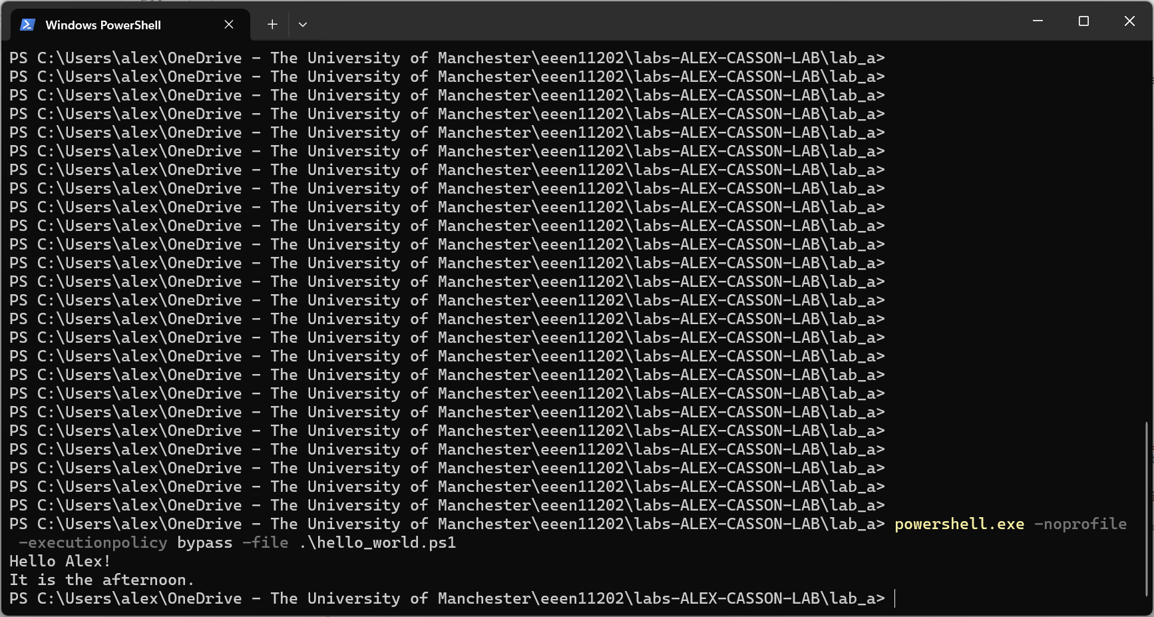
Input command
Displayed output

Slide 23
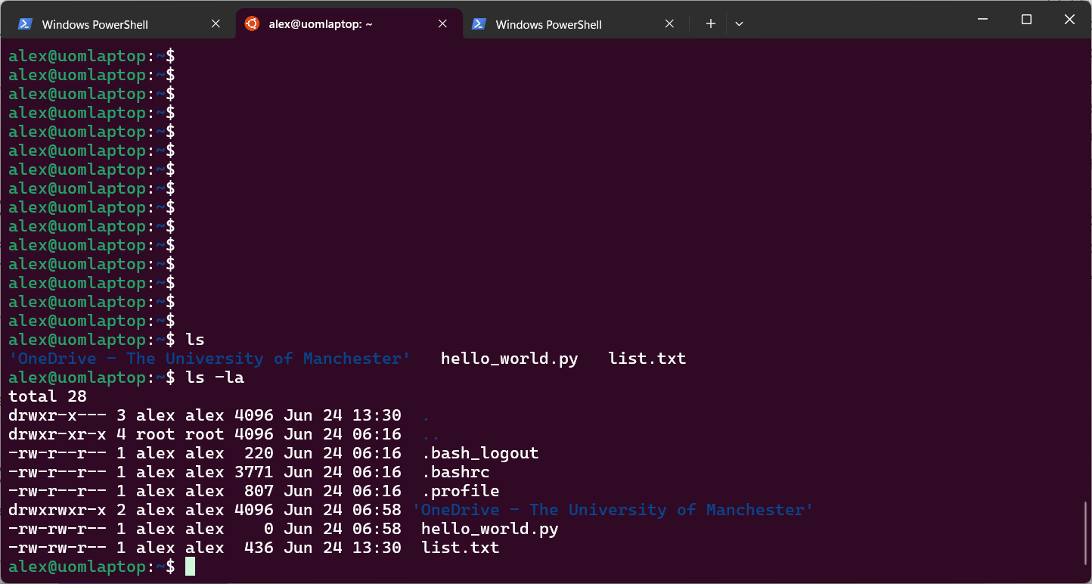

Slide 24
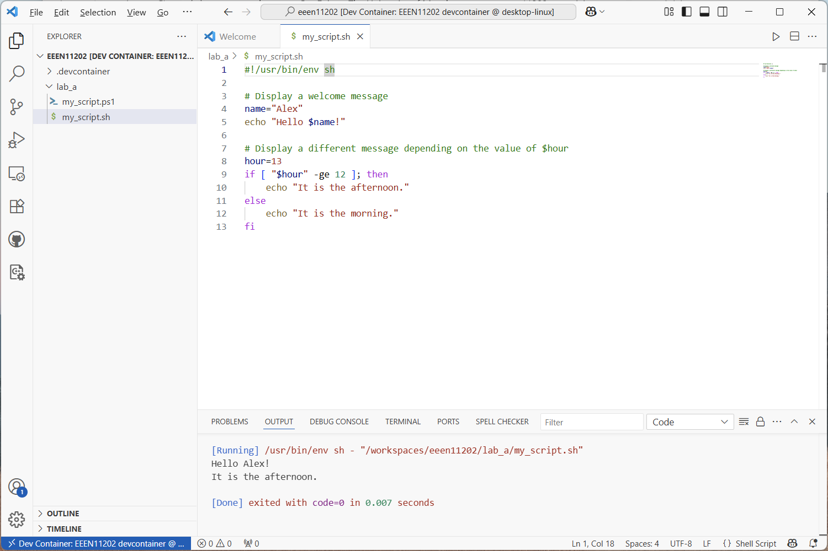
Run button
Displayed output

Slide 25
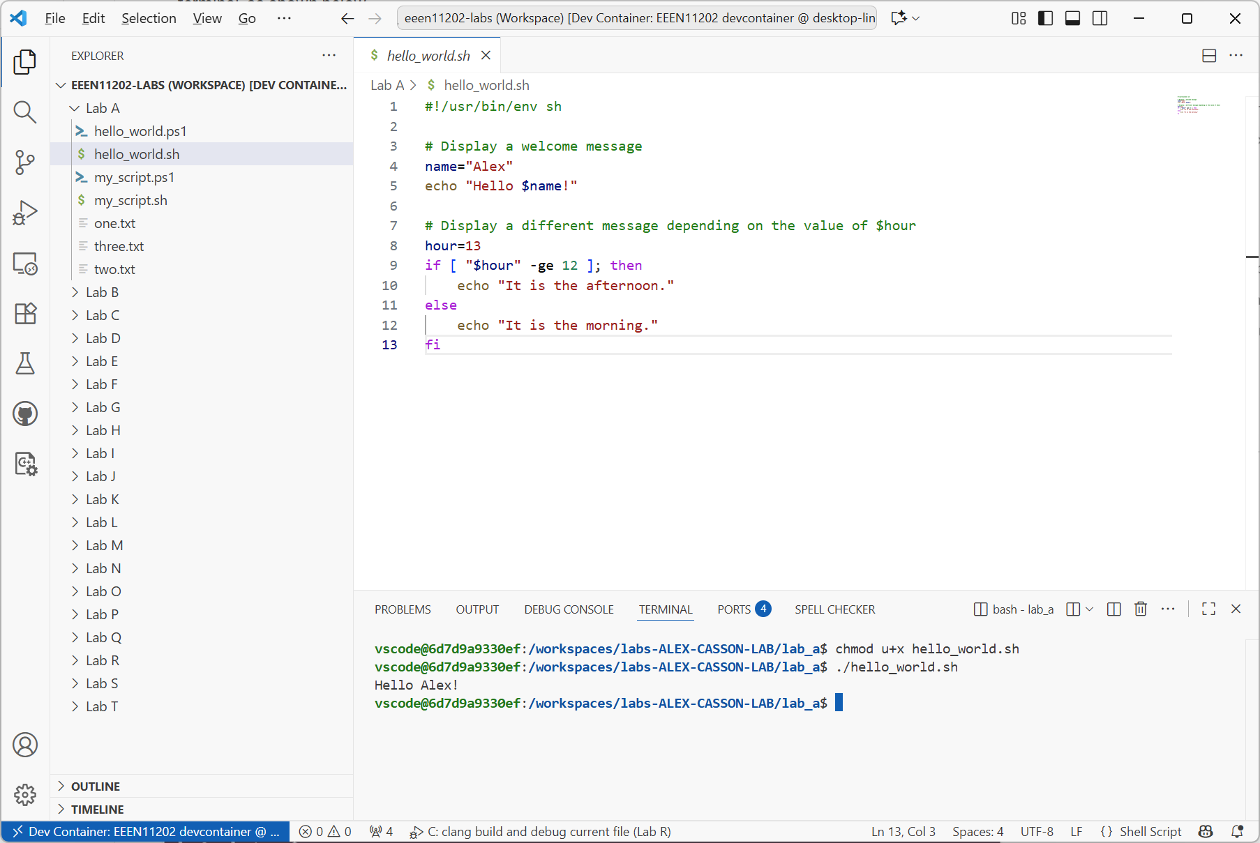
Commands
Displayed output

Slide 26
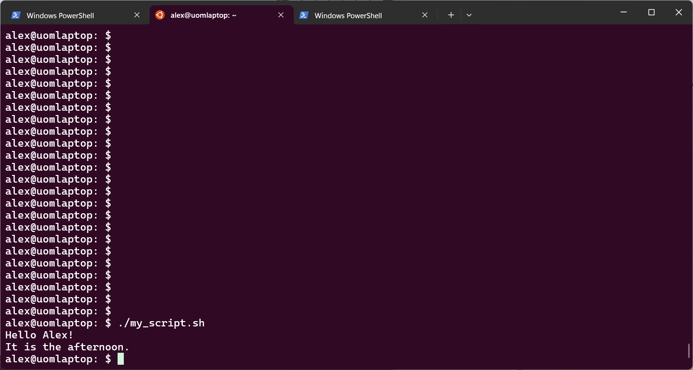
Input command
Displayed output

Slide 27
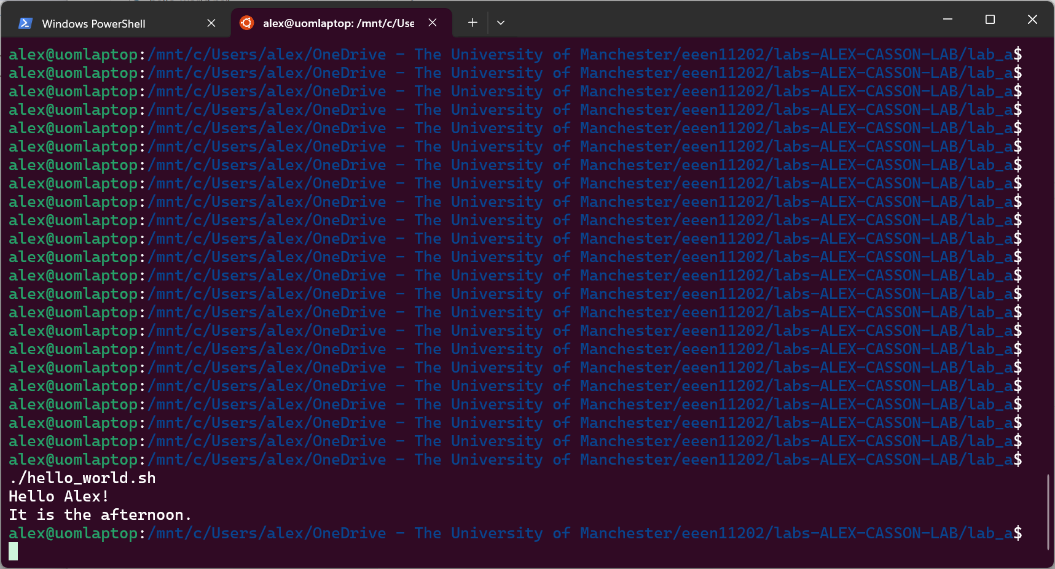
Input command
Displayed output

Slide 28
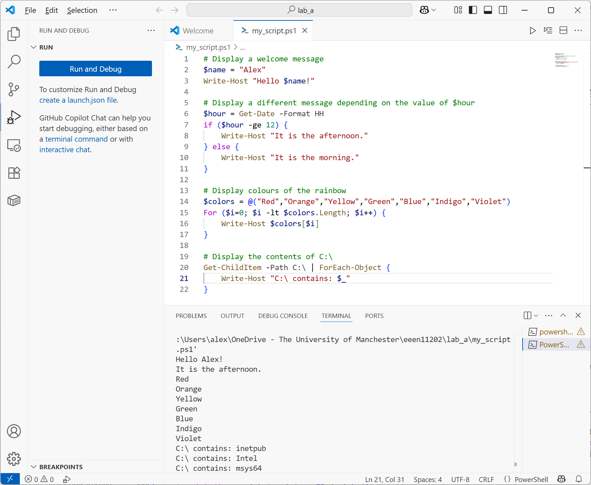
Run button
New code
Displayed output

Slide 29
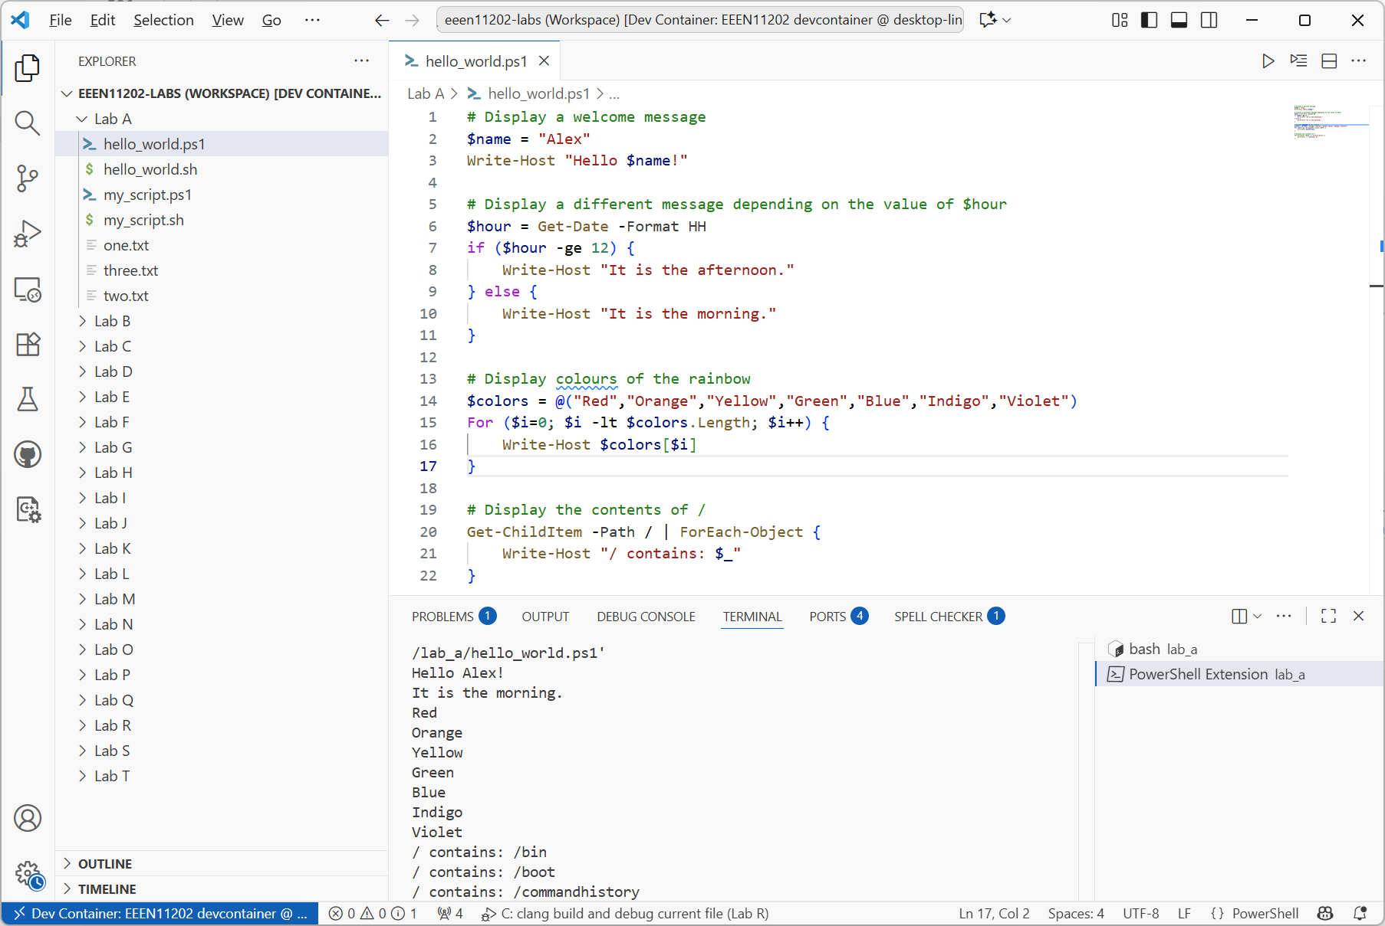
Run button
New code
Displayed output

Slide 30
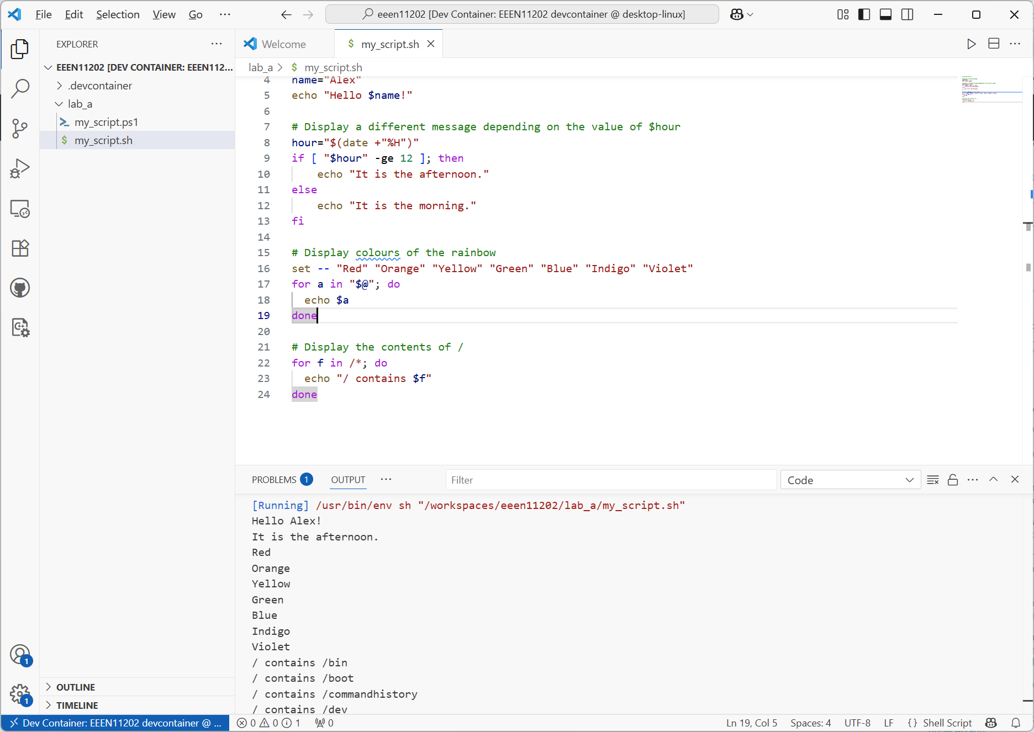
Run button
New code
Displayed output

Slide 31
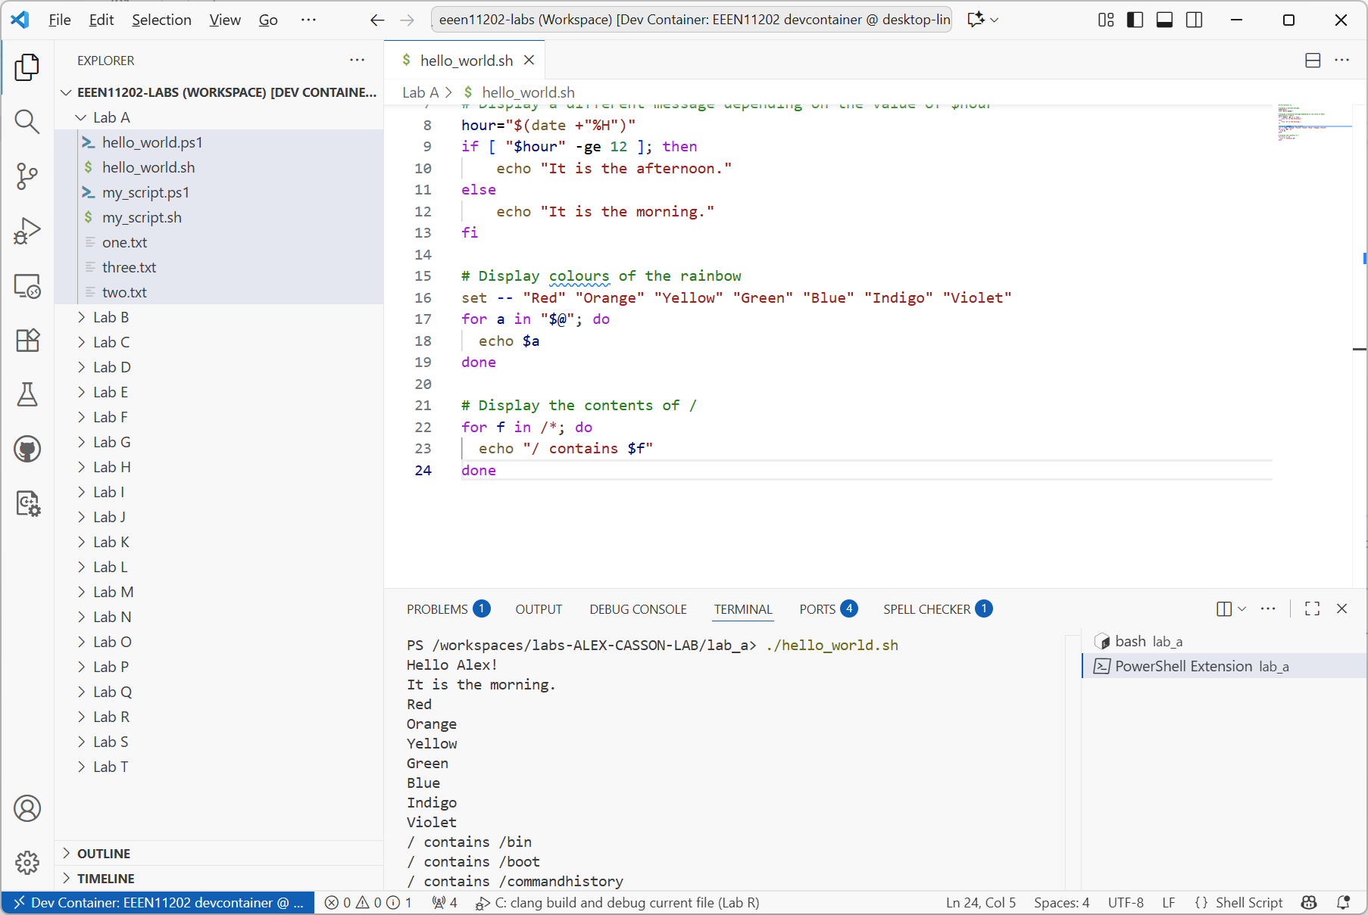
New code
Command
Displayed output

Slide 32
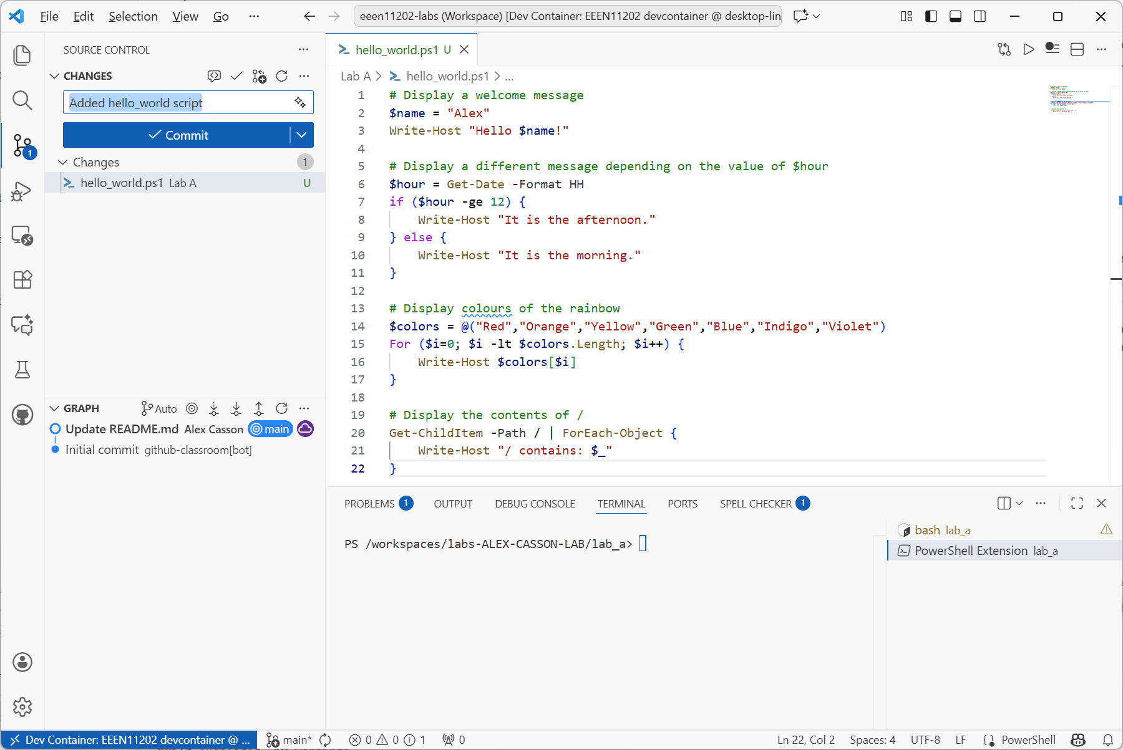
1
2
3

Slide 33
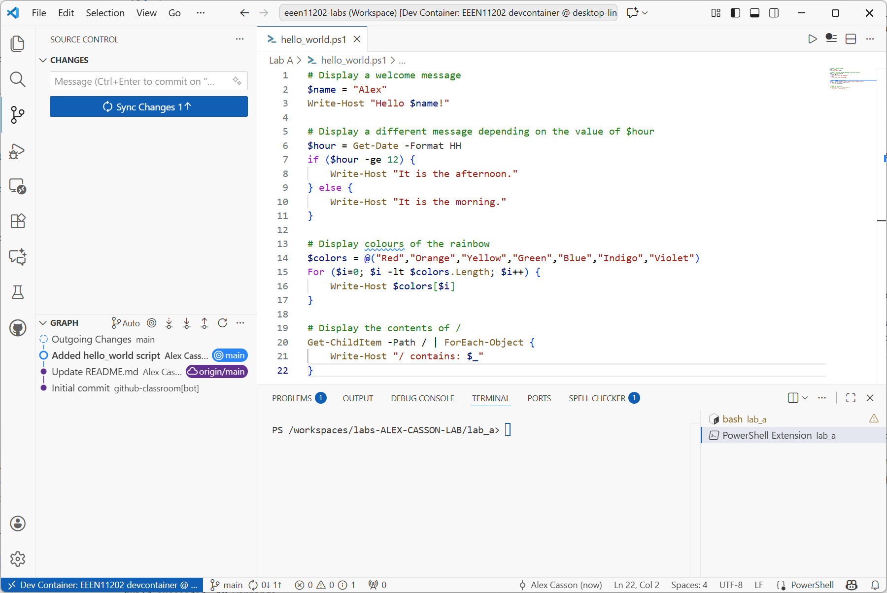

Slide 34
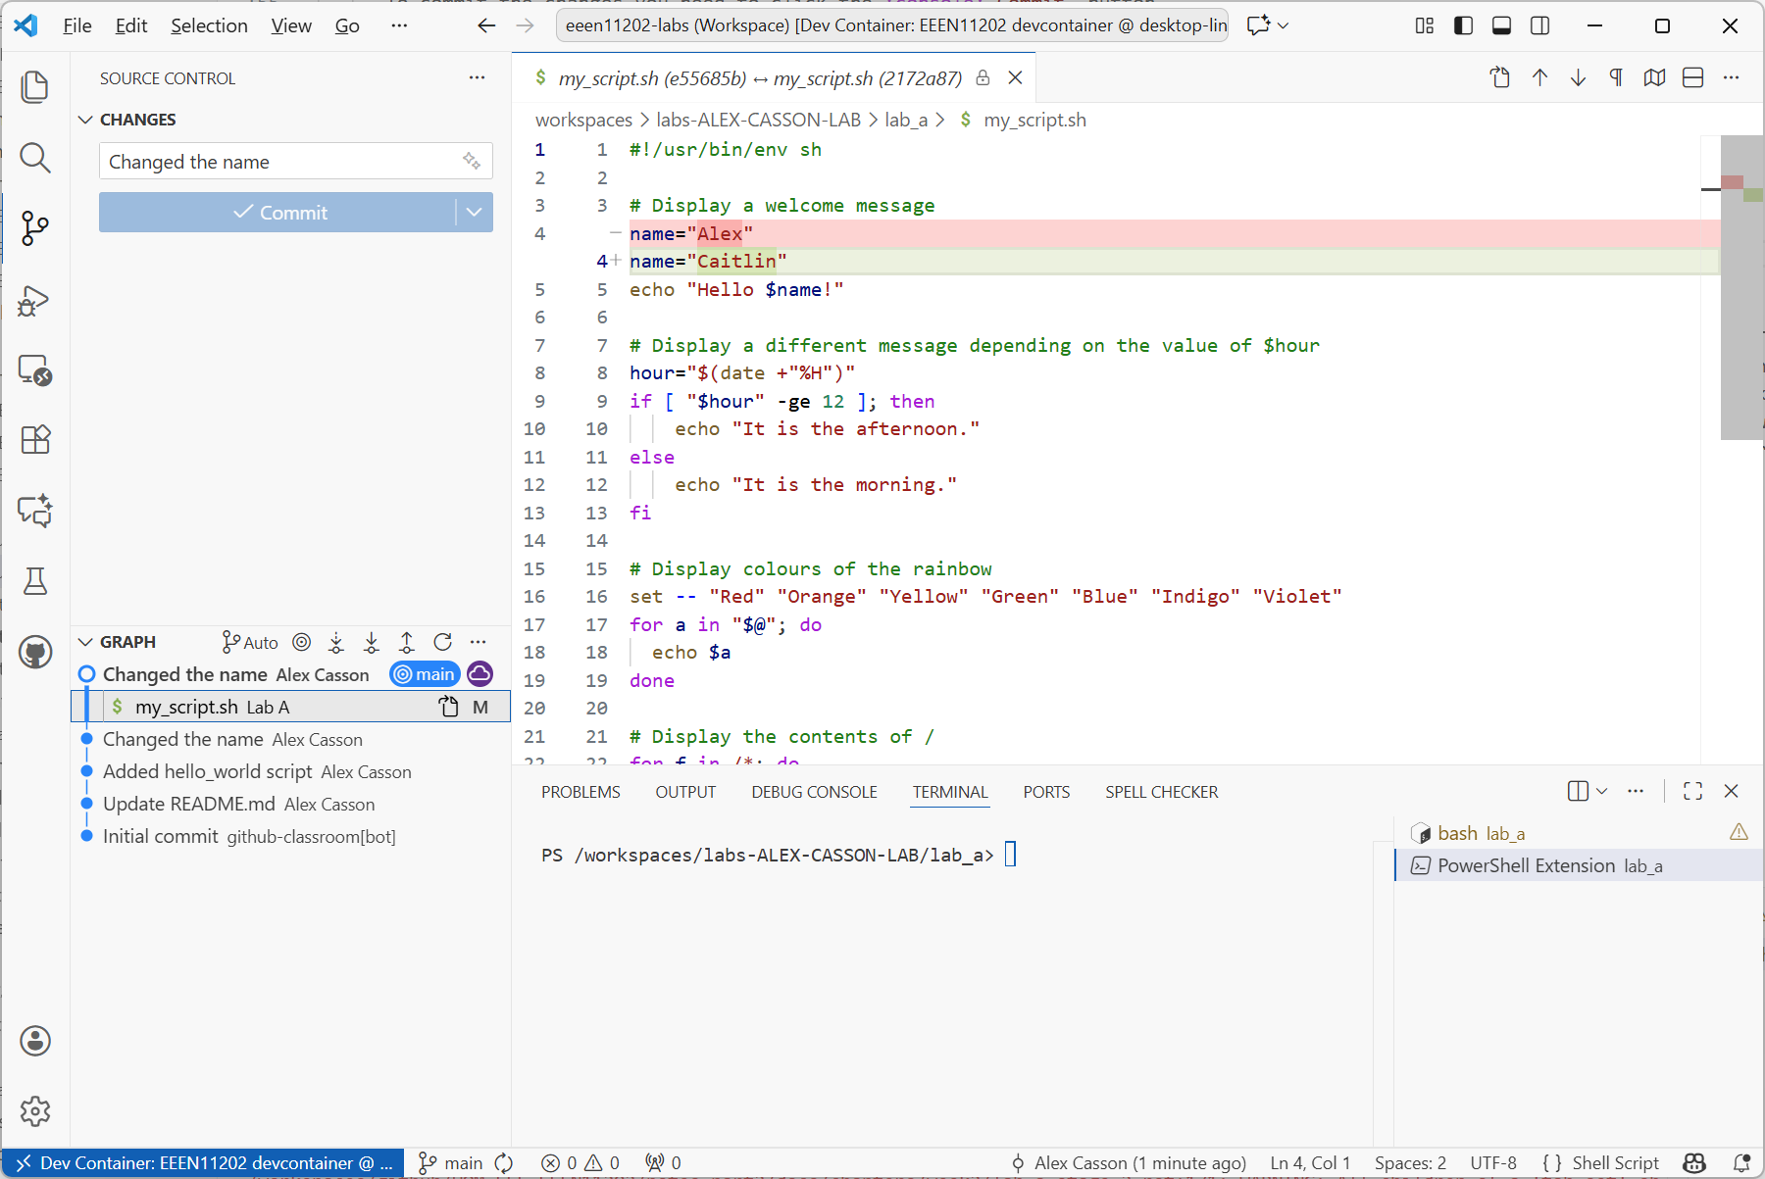

Slide 35
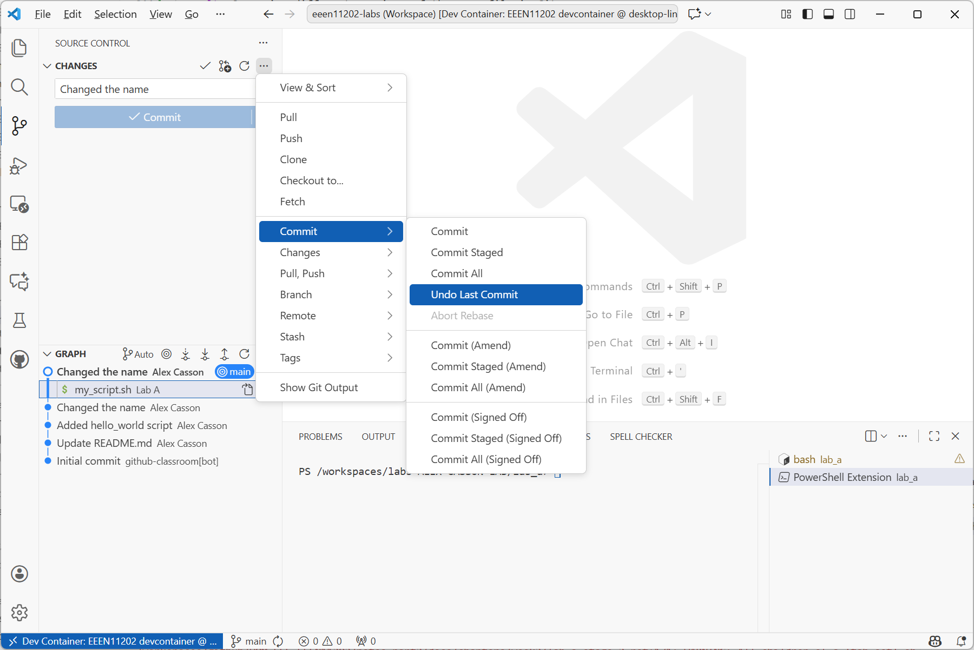

Slide 36
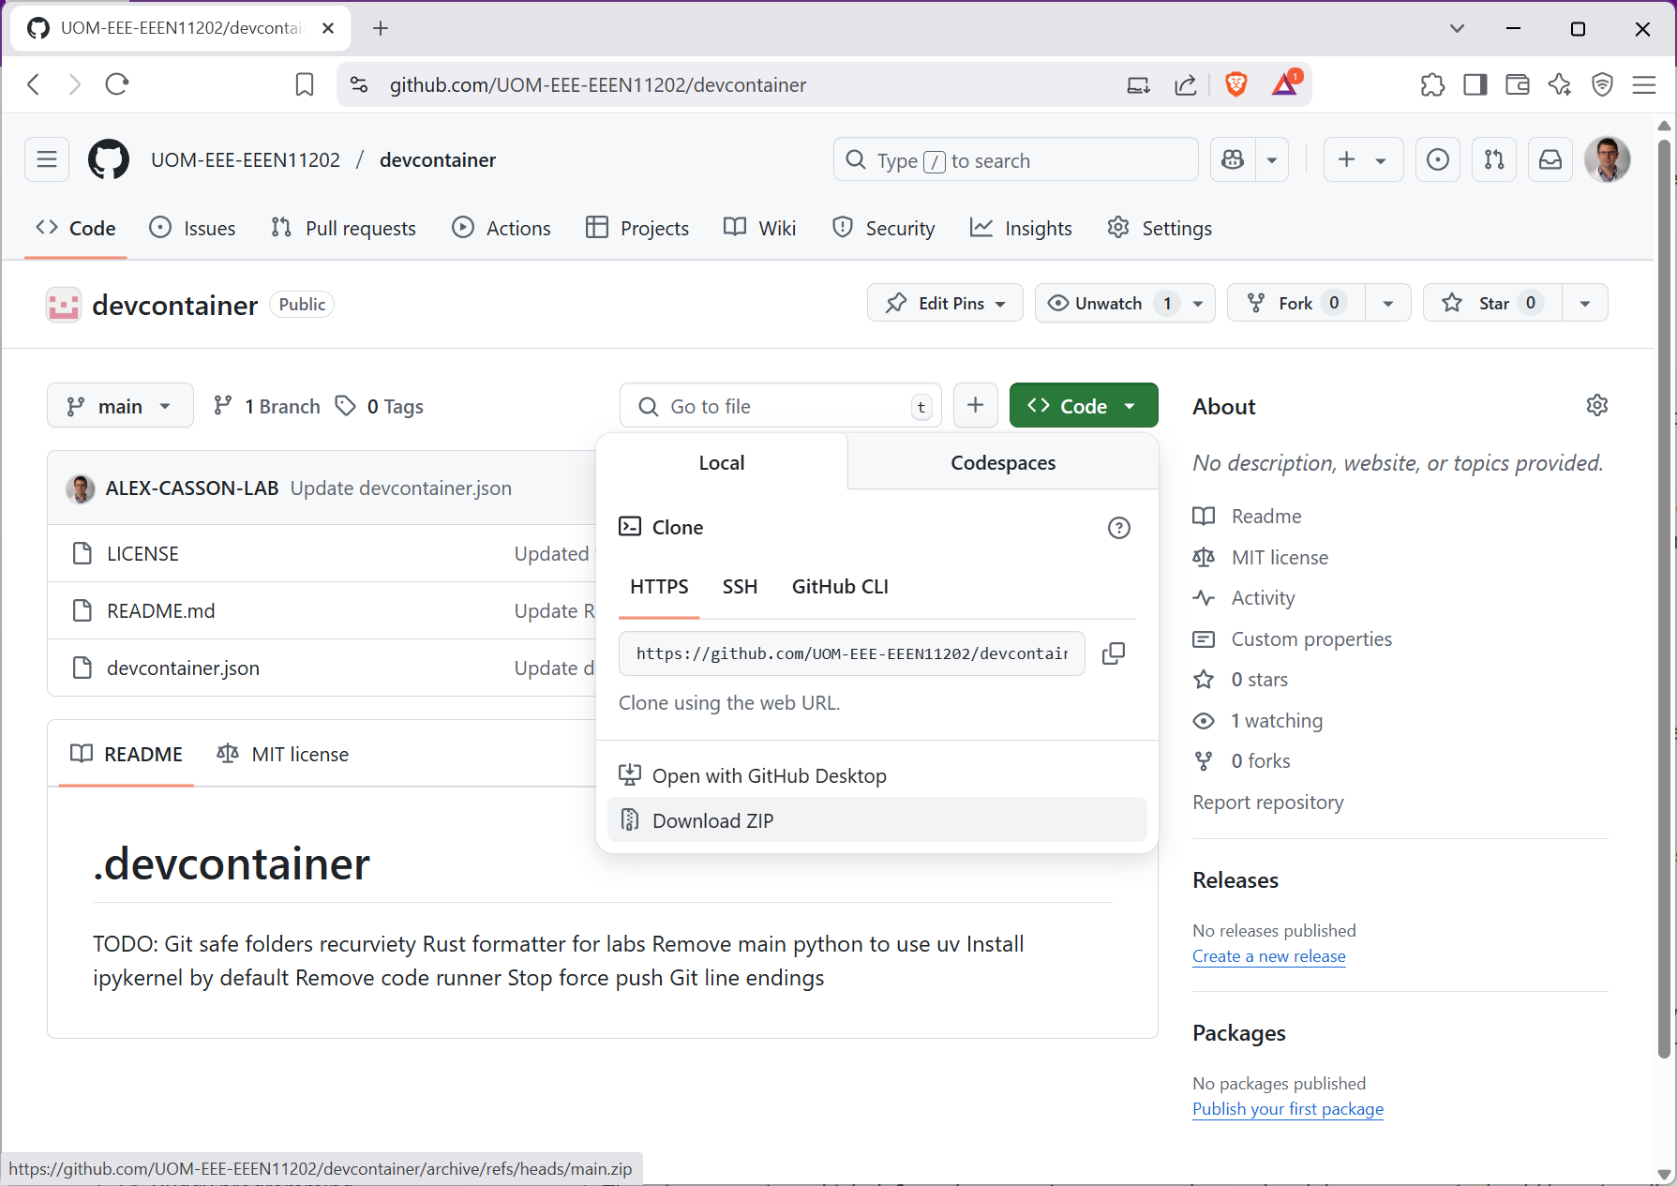

Slide 37
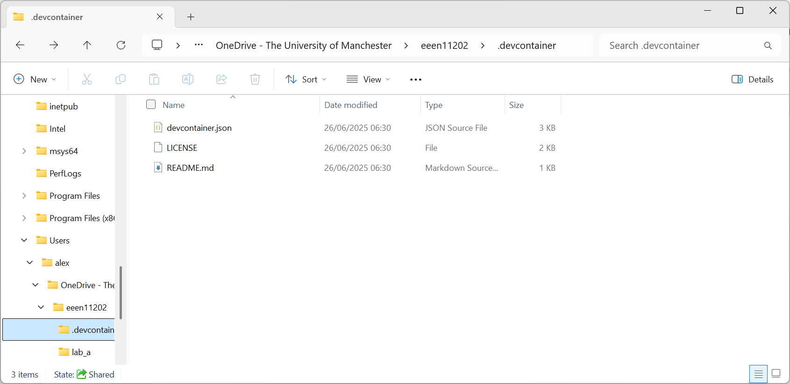
Copied filed
.devcontainer folder inside eeen11202 folder

Slide 38
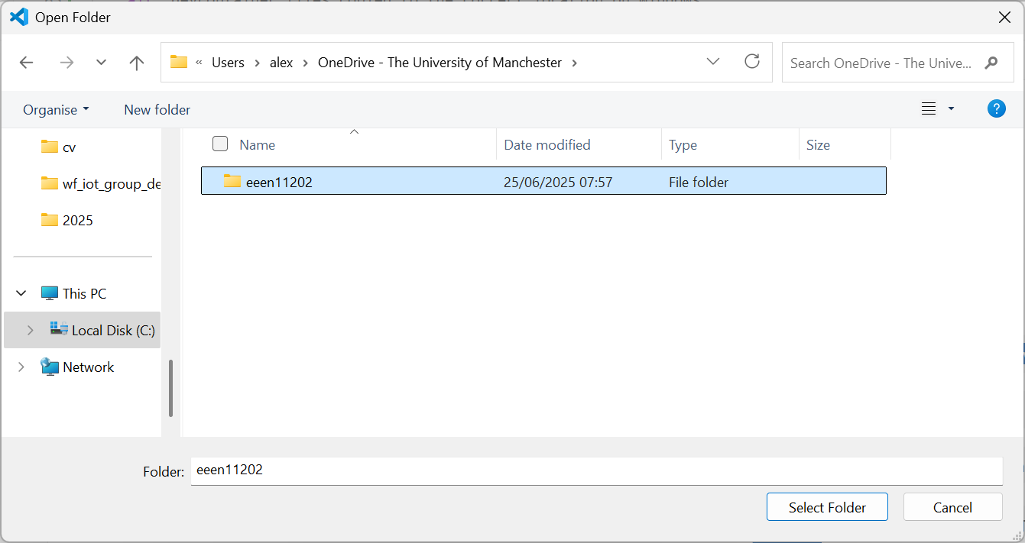
Select eeen11202, not .devcontainer

Slide 39
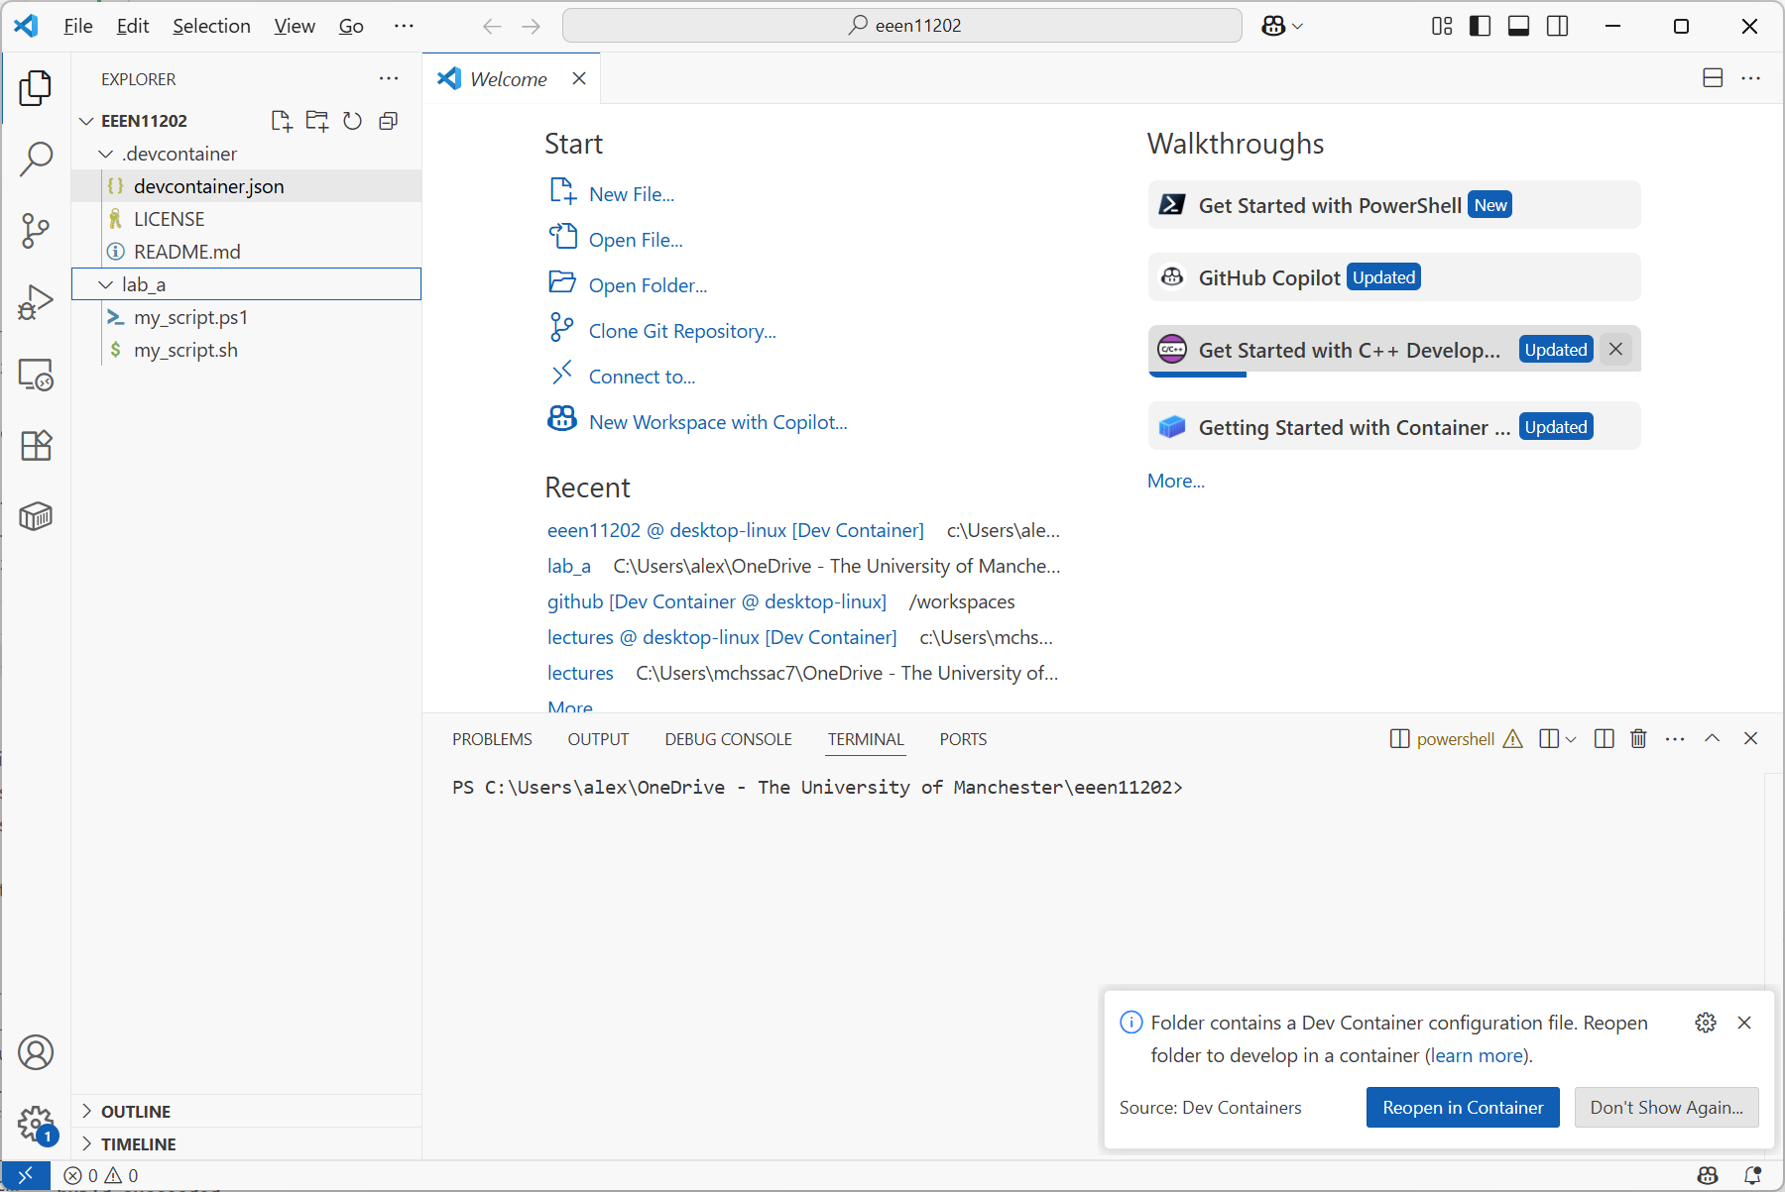

Slide 40
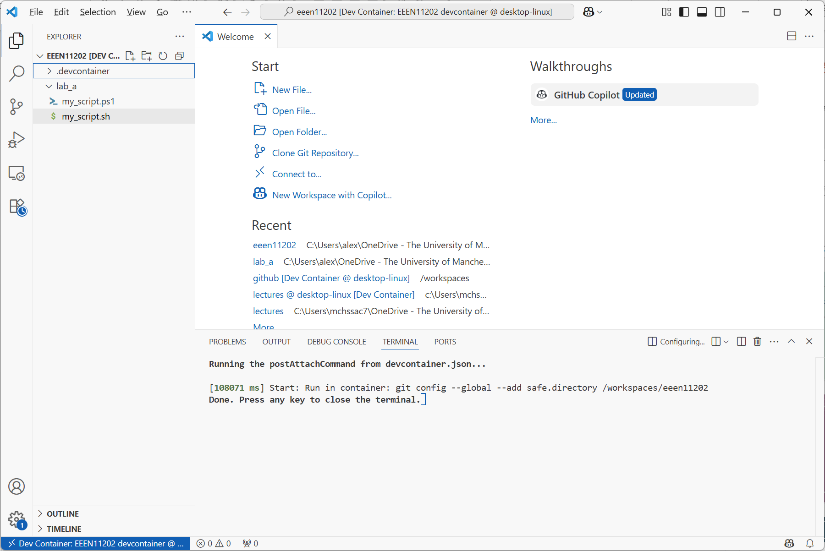

Slide 41
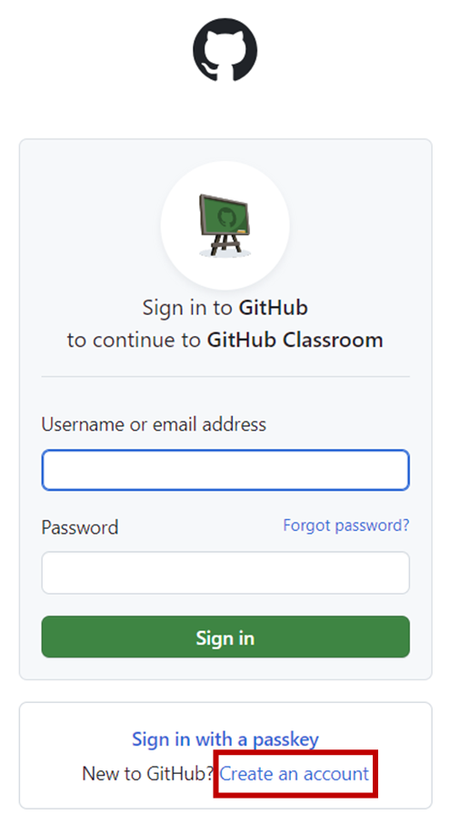

Slide 42
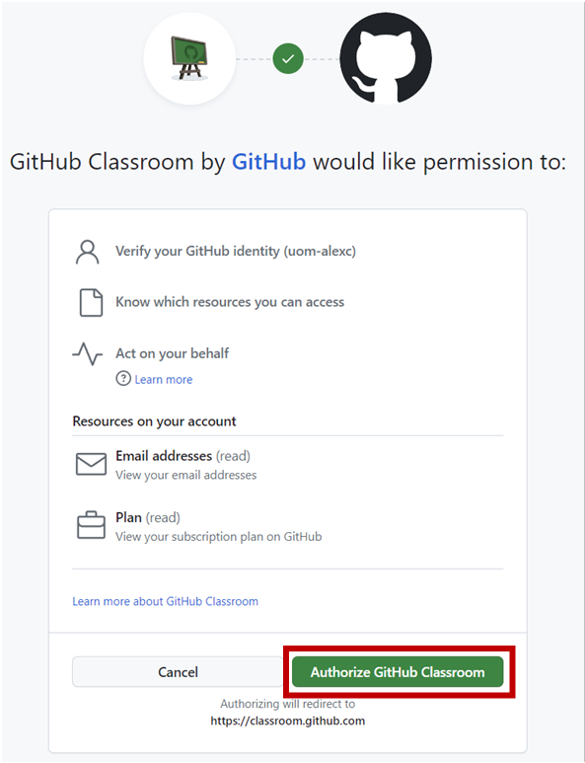

Slide 43
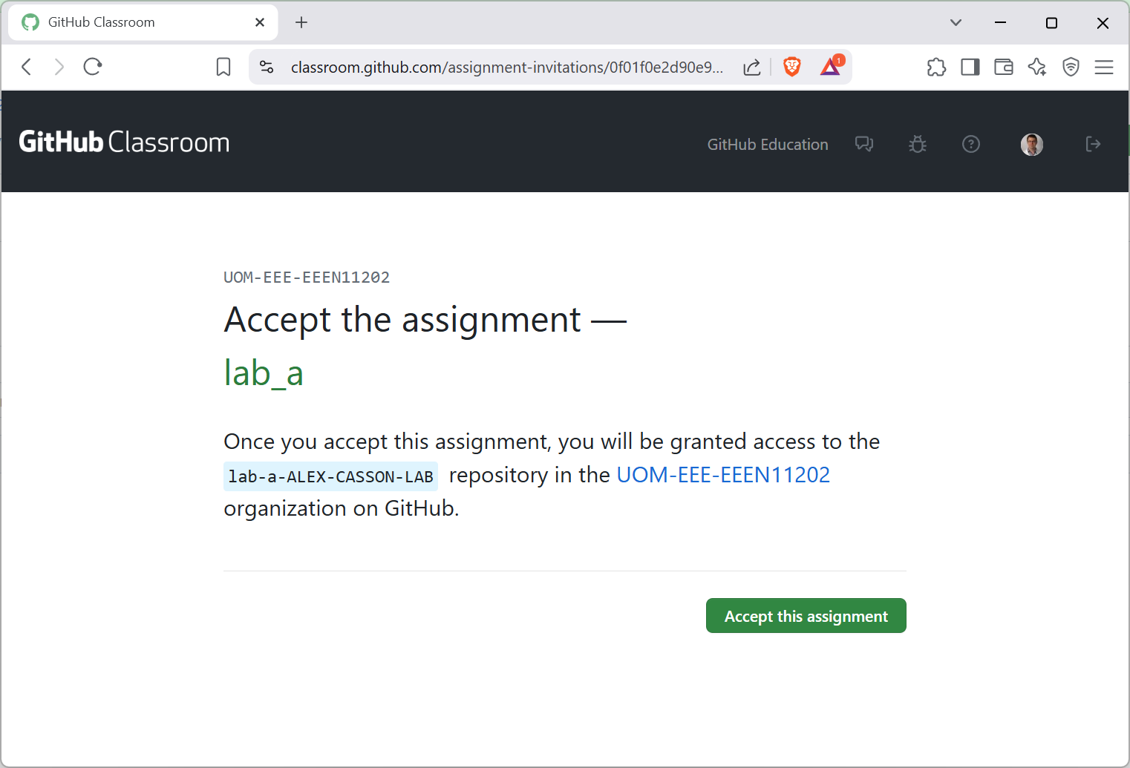

Slide 44
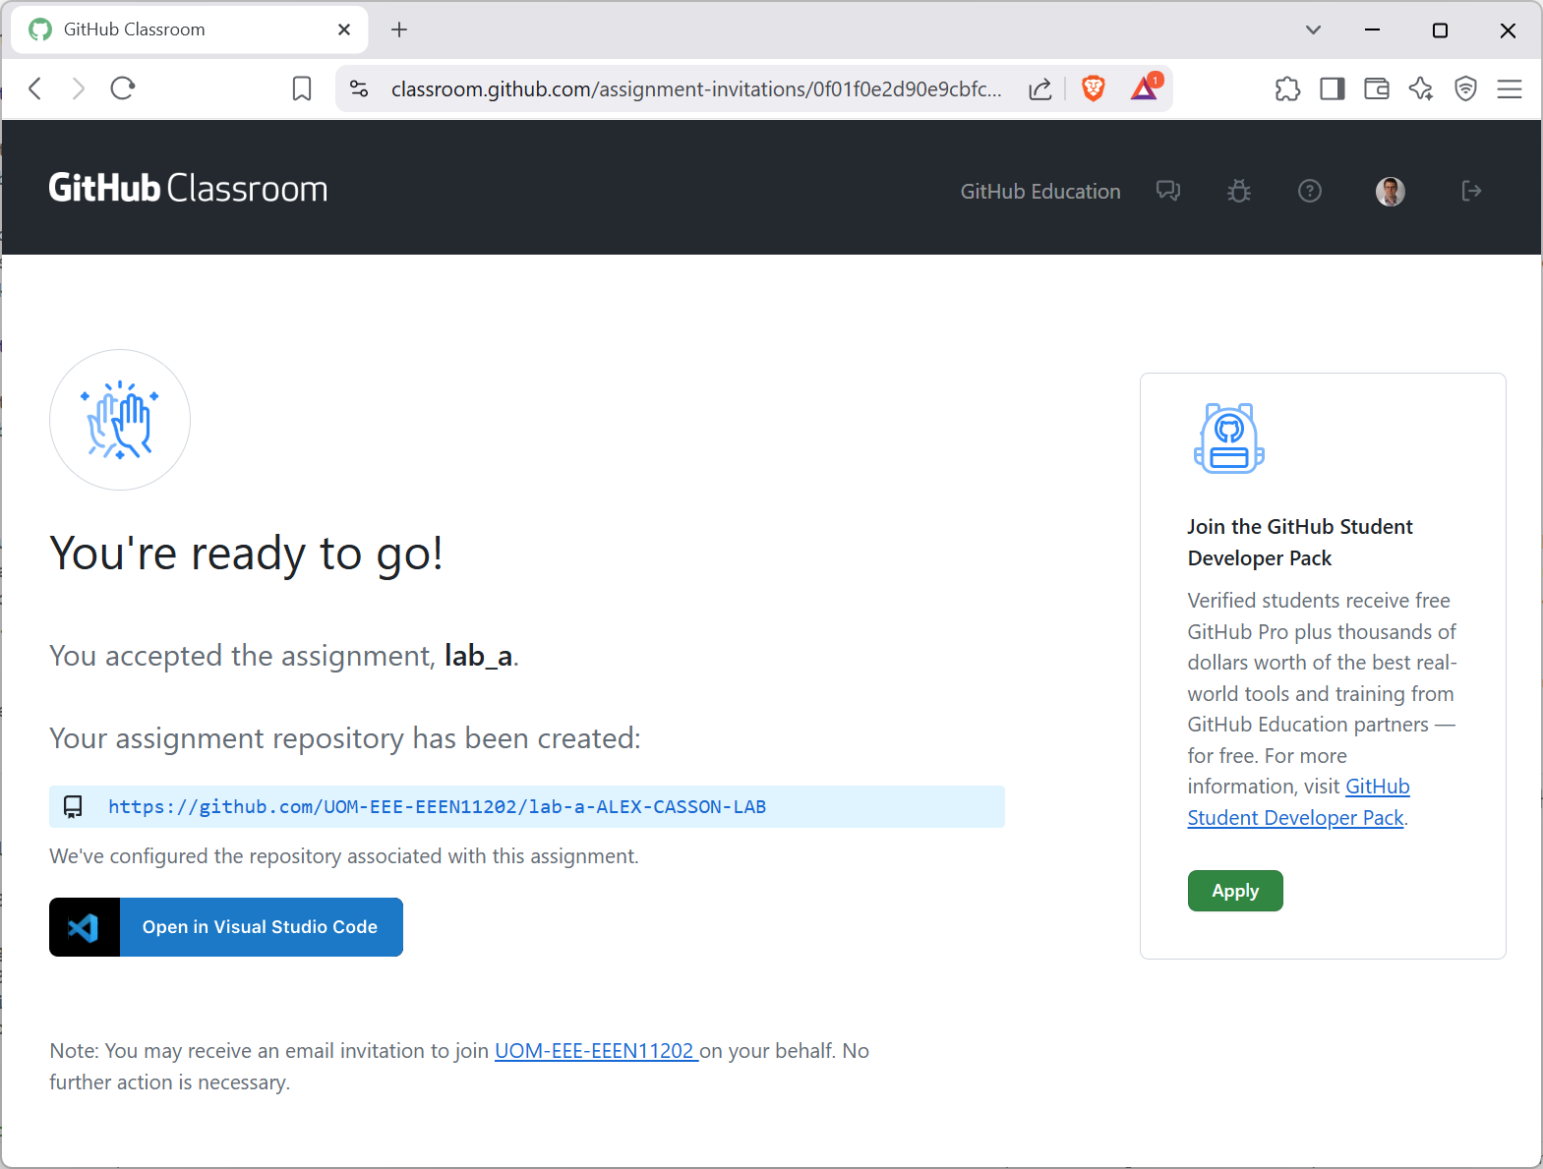

Slide 45
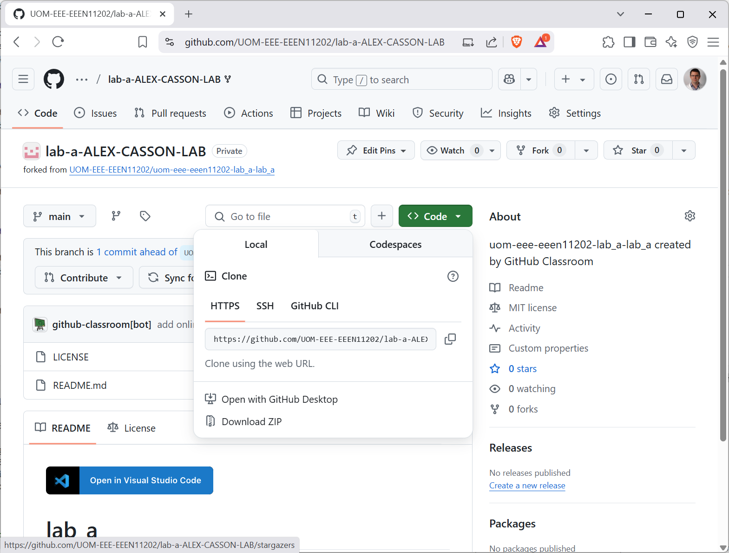
Files

Slide 46
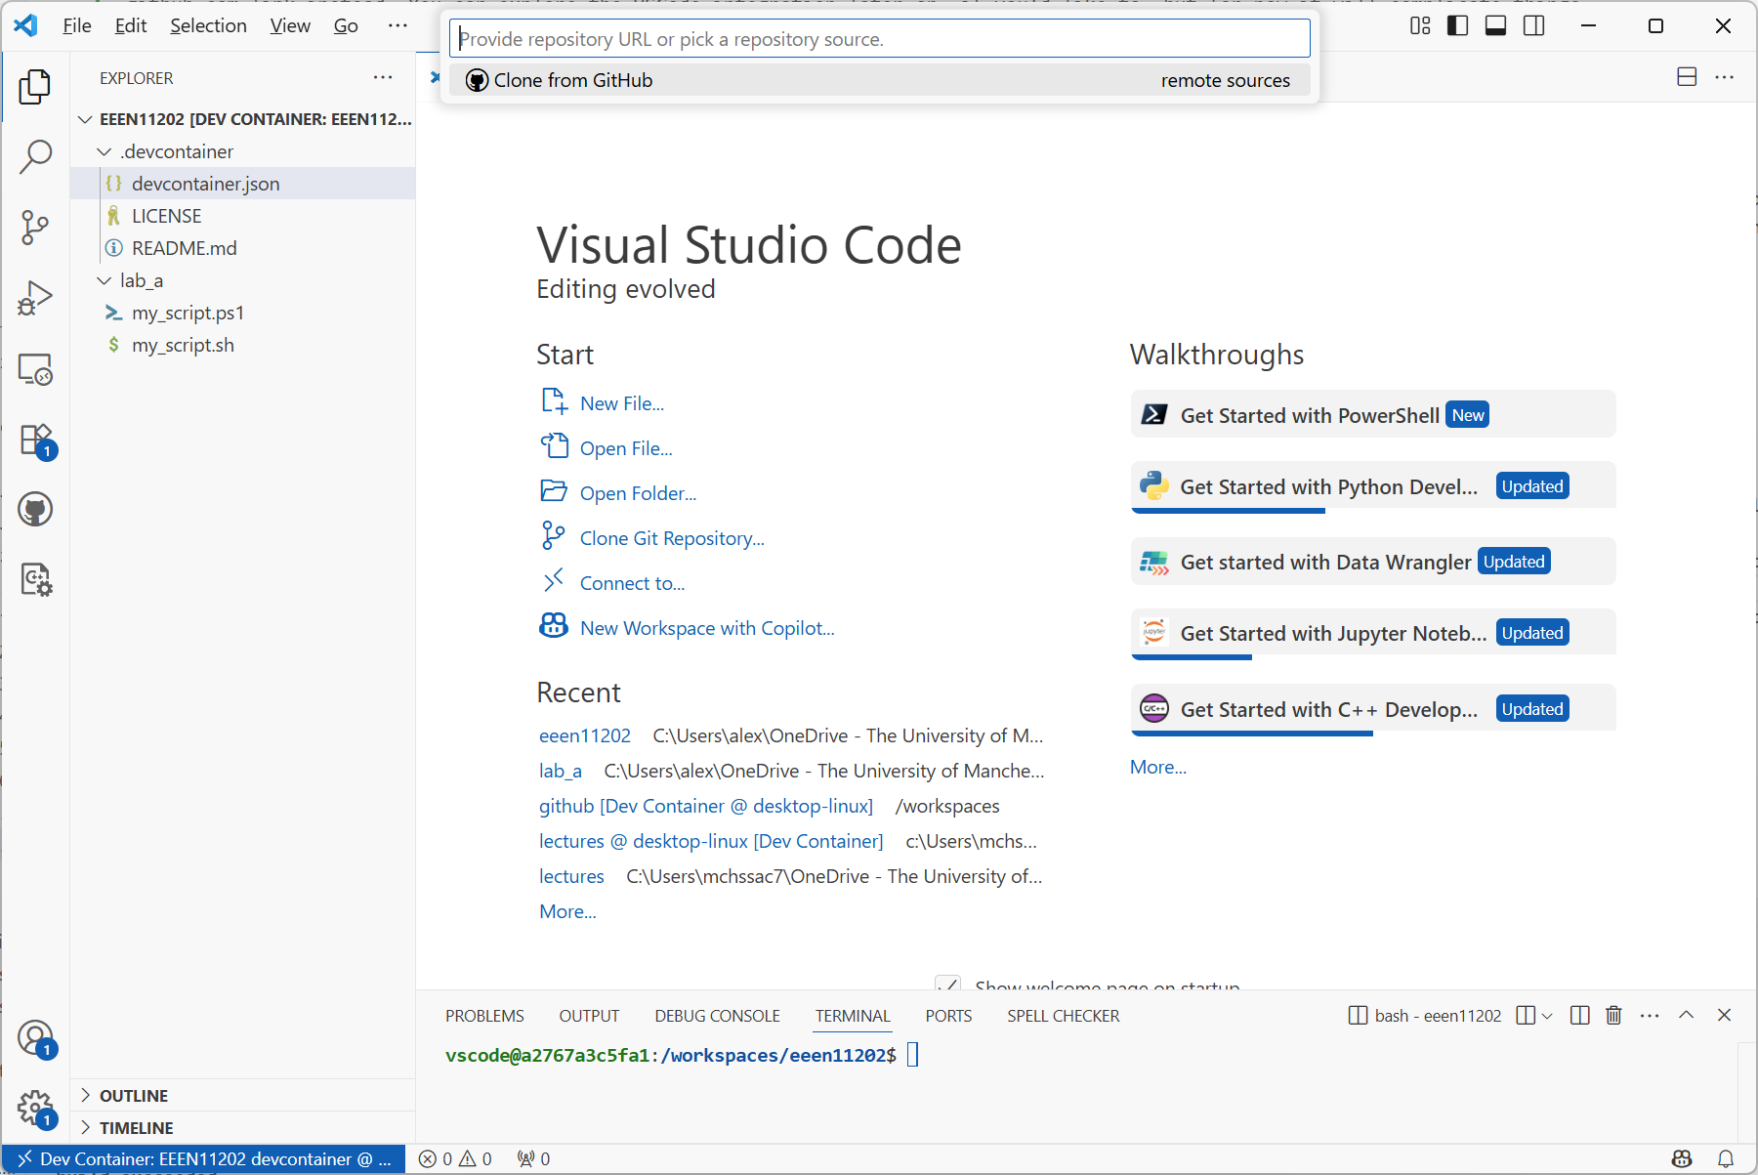
2.
1.

Slide 47
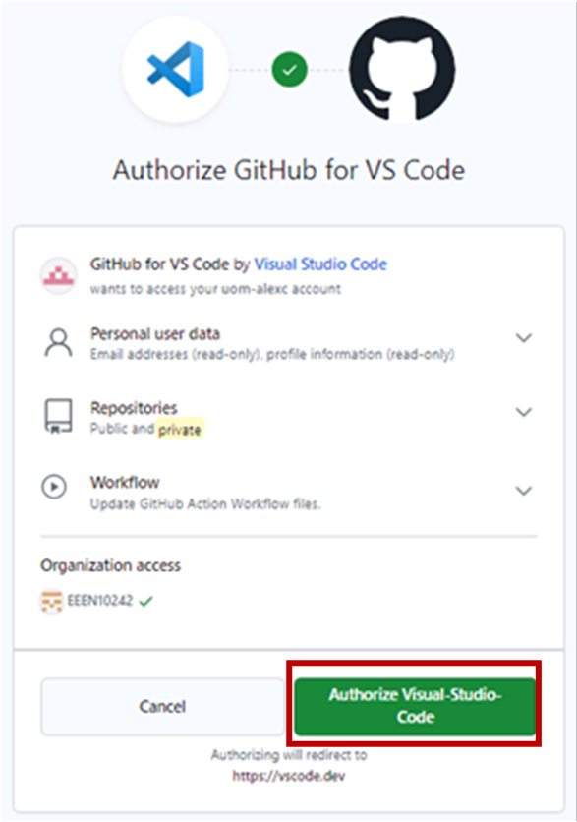

Slide 48
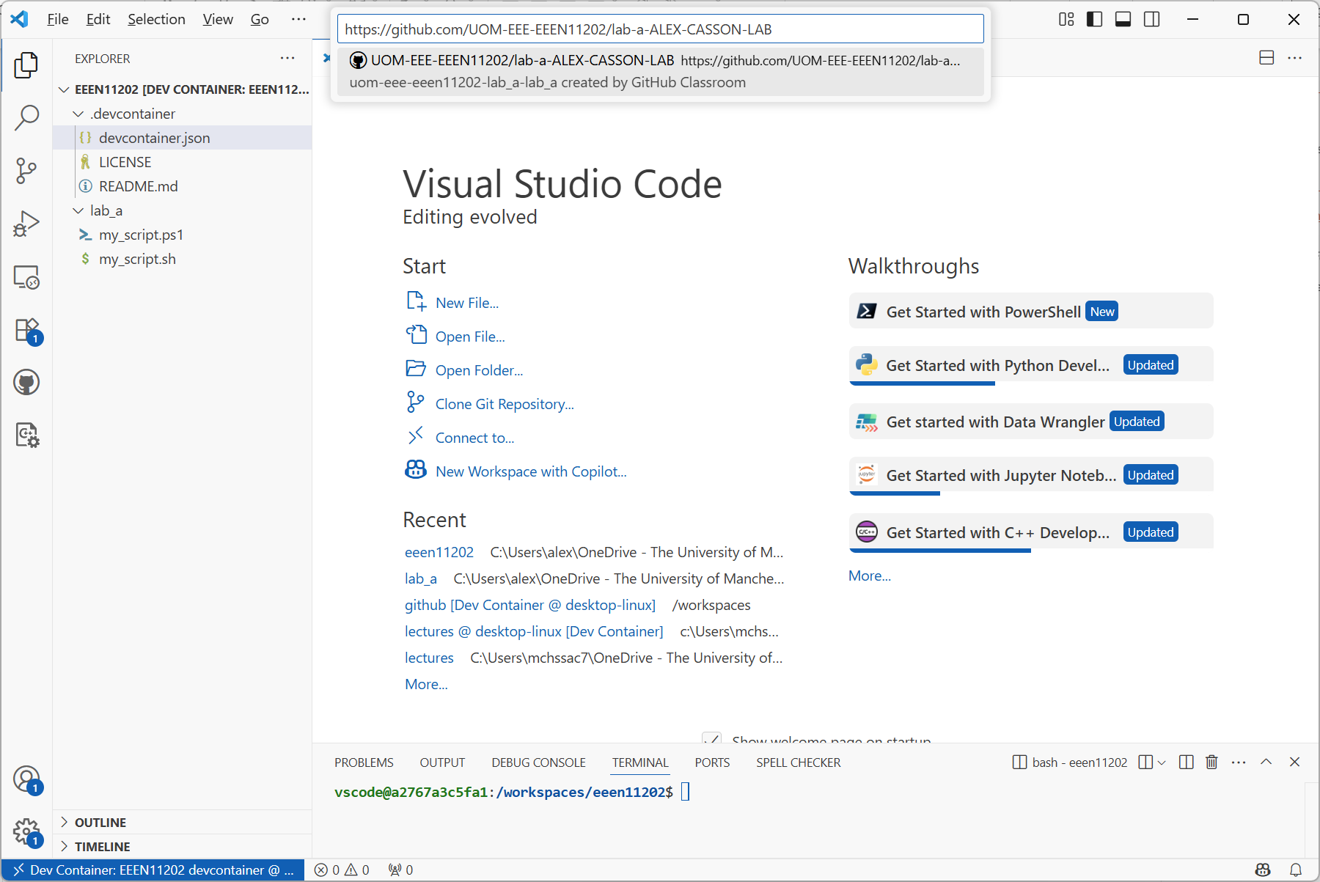

Slide 49
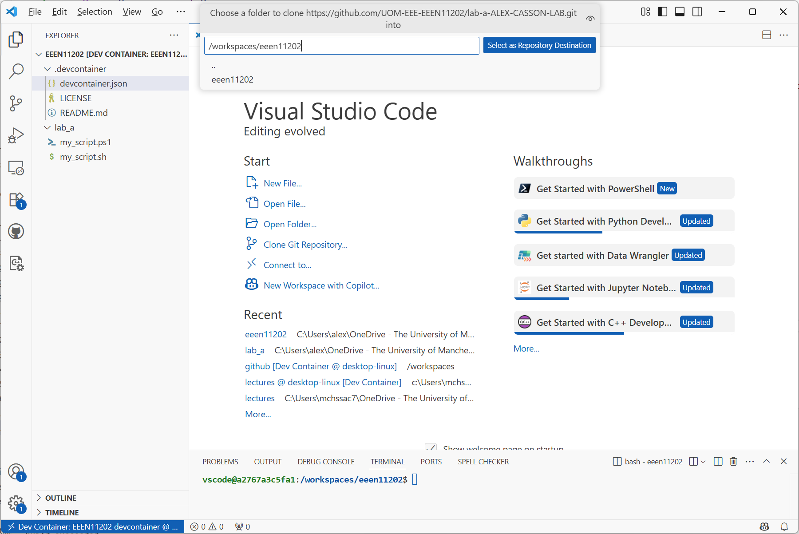

Slide 50


Slide 51


Slide 52

Our folder structure

Slide 53


Slide 54


Slide 55


Slide 56


Slide 57


Slide 58


Slide 59


Slide 60


